Slide 1
44th International Conference on Software Engineering (ICSE 2022)
Characterizing and Detecting Bugs in WeChat Mini-Programs
Tao Wang, Qingxin Xu, Xiaoning Chang, Wensheng Dou, Jiaxin Zhu,
Jinhui Xie, Yuetang Deng, Jianbo Yang, Jiaheng Yang, Jun Wei, Tao Huang
Institute of Software,
Chinese Academy of Sciences
University of Chinese Academy of Sciences
Tencent Inc.

Slide 2
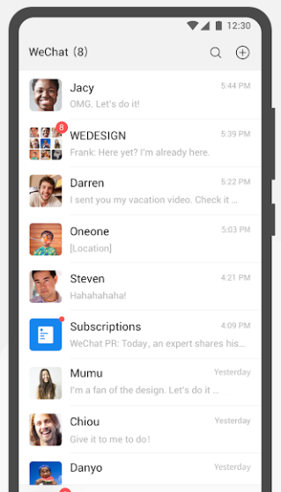
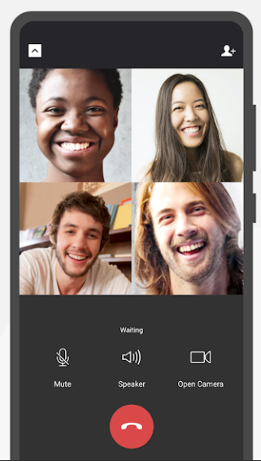
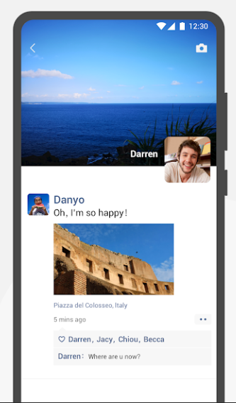
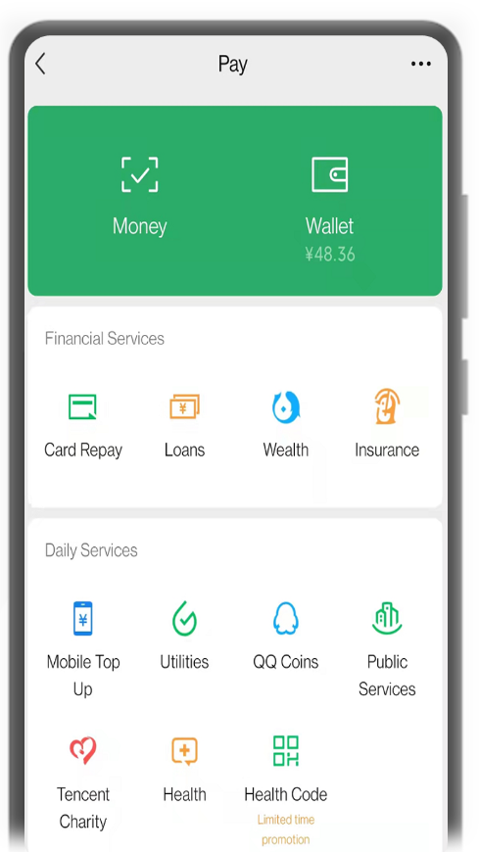
WeChat
Chat
Video
Moments
Payment
More than a messaging and social media app,
connecting more than 1 billion people.

Slide 3
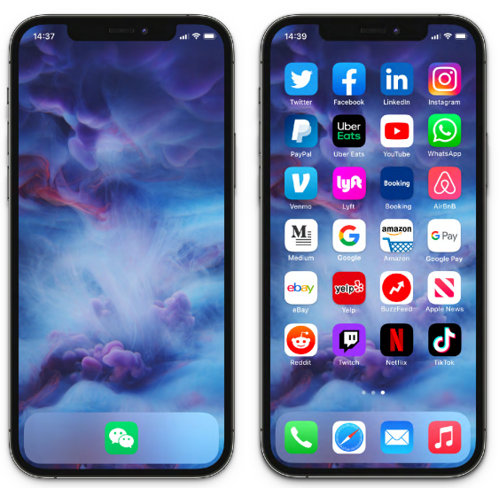
WeChat Mini-Program
App-like platforms that exist within the WeChat app itself
No need to download and install
Smooth as native Android and iOS apps
Imagine if just this …
… could replace all of these.

Slide 4
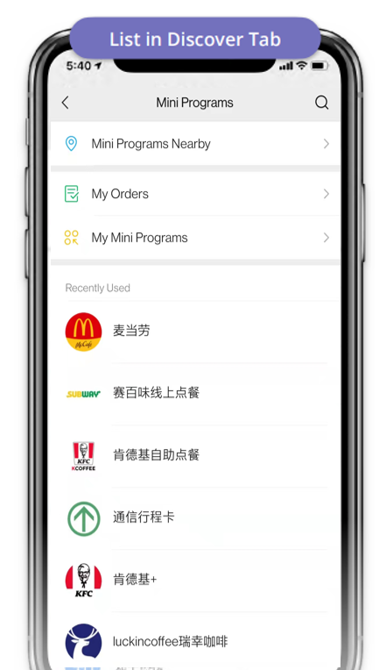
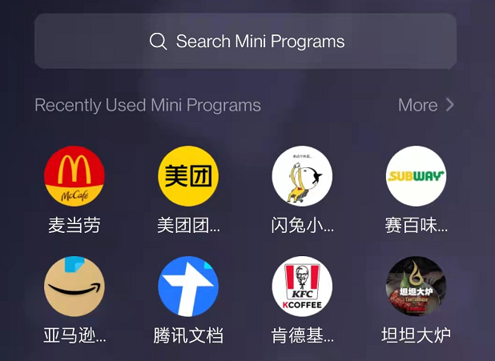
Mini-Programs are deeply integrated into WeChat
Shared in Chat
Slide Down Tray
List in Discover Tab

Slide 5
WeChat Mini-Programs are widely used
More than 3.2 million WeChat Mini-Programs [1]
Rapid growth [2]
1,250M
1,268M
1097M
1151M
989M
WeChat MAU
MAU: monthly active users
829M
854M
746M
491M
Mini-Program MAU
34M
[1] https://daxueconsulting.com/wechat-mini-programs-2020-report/
[2] https://kawo.com/en/ultimate-guide-to-china-social-media-marketing-2022

Slide 6
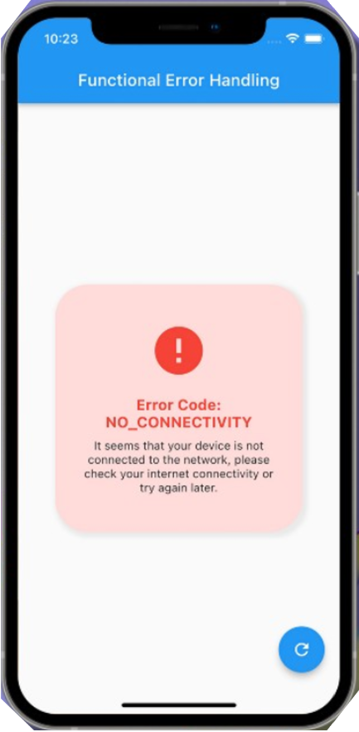
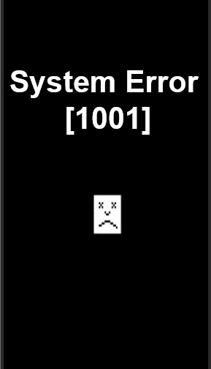
A simplified WeChat Mini-Program
// index.wxml
<view> Hello {{name}}! </view>
<button bindtap="changeName">
Click me!
</button>
Page structure
Hello $name!
Click me!

Slide 7
A simplified WeChat Mini-Program
// index.wxml
<view> Hello {{name}}! </view>
<button bindtap="changeName">
Click me!
</button>
Page structure
Hello $name!
// index.wxss
button{
background-color: blue;
width: 70%;
margin-top: 70%;
}
Click me!
Page style

Slide 8
A simplified WeChat Mini-Program
// index.wxml
<view> Hello {{name}}! </view>
<button bindtap="changeName">
Click me!
</button>
// index.js
var helloData = {
name: 'WeChat'
}
Page({
data: helloData,
changeName: function (e){
this.setData({
name: 'World'
})
...
Page structure
Hello $name!
// index.wxss
button{
background-color: blue;
width: 70%;
margin-top: 70%;
}
Click me!
Page logic
Page style

Slide 9
A simplified WeChat Mini-Program
// index.wxml
<view> Hello {{name}}! </view>
<button bindtap="changeName">
Click me!
</button>
// index.js
var helloData = {
name: 'WeChat'
}
Page({
data: helloData,
changeName: function (e){
this.setData({
name: 'World'
})
...
Page structure
Hello WeChat!
// index.wxss
button{
background-color: blue;
width: 70%;
margin-top: 70%;
}
Click me!
Page logic
Page style

Slide 10
A simplified WeChat Mini-Program
// index.wxml
<view> Hello {{name}}! </view>
<button bindtap="changeName">
Click me!
</button>
// index.js
var helloData = {
name: 'WeChat'
}
Page({
data: helloData,
changeName: function (e){
this.setData({
name: 'World'
})
...
Page structure
Hello WeChat!
// index.wxss
button{
background-color: blue;
width: 70%;
margin-top: 70%;
}
Click me!
Page logic
Page style

Slide 11
A simplified WeChat Mini-Program
// index.wxml
<view> Hello {{name}}! </view>
<button bindtap="changeName">
Click me!
</button>
Page structure
Hello WeChat!
Hello World!
// index.wxss
button{
background-color: blue;
width: 70%;
margin-top: 70%;
}
Click me!
Click me!
Page style

Slide 12
WeChat Mini-Program development framework
Render layer
Logic layer
Program logic
UI display
WXML
WXSS
JavaScript core
event
data
data
event
Binding function
…
location
bluetooth
file access
payment

Slide 13
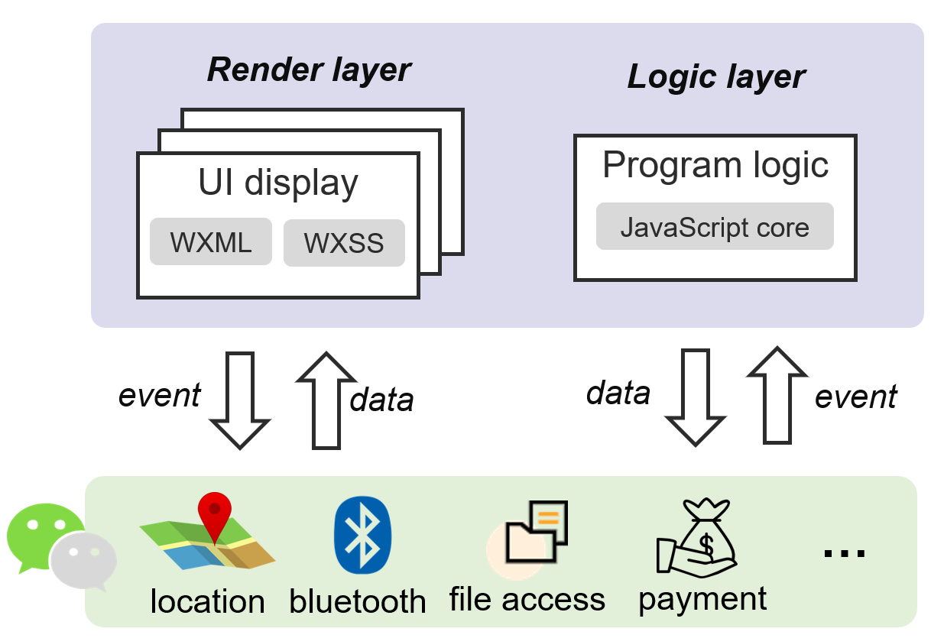
WeChat Mini-Program Bug
Bugs can occur during the development of Mini-Programs
We call WeChat Mini-Programs bug as WeBug
JavaScript bugs
Compatibility bugs
Asynchronous bugs
…

Slide 14
WeBugs are common
WeBugs can lead to runtime errors
Hundred millions of runtime errors are reported everyday [1]
120M
100M
80M
60M
40M
20M
[1] WeChat internal monitoring platform.

Slide 15
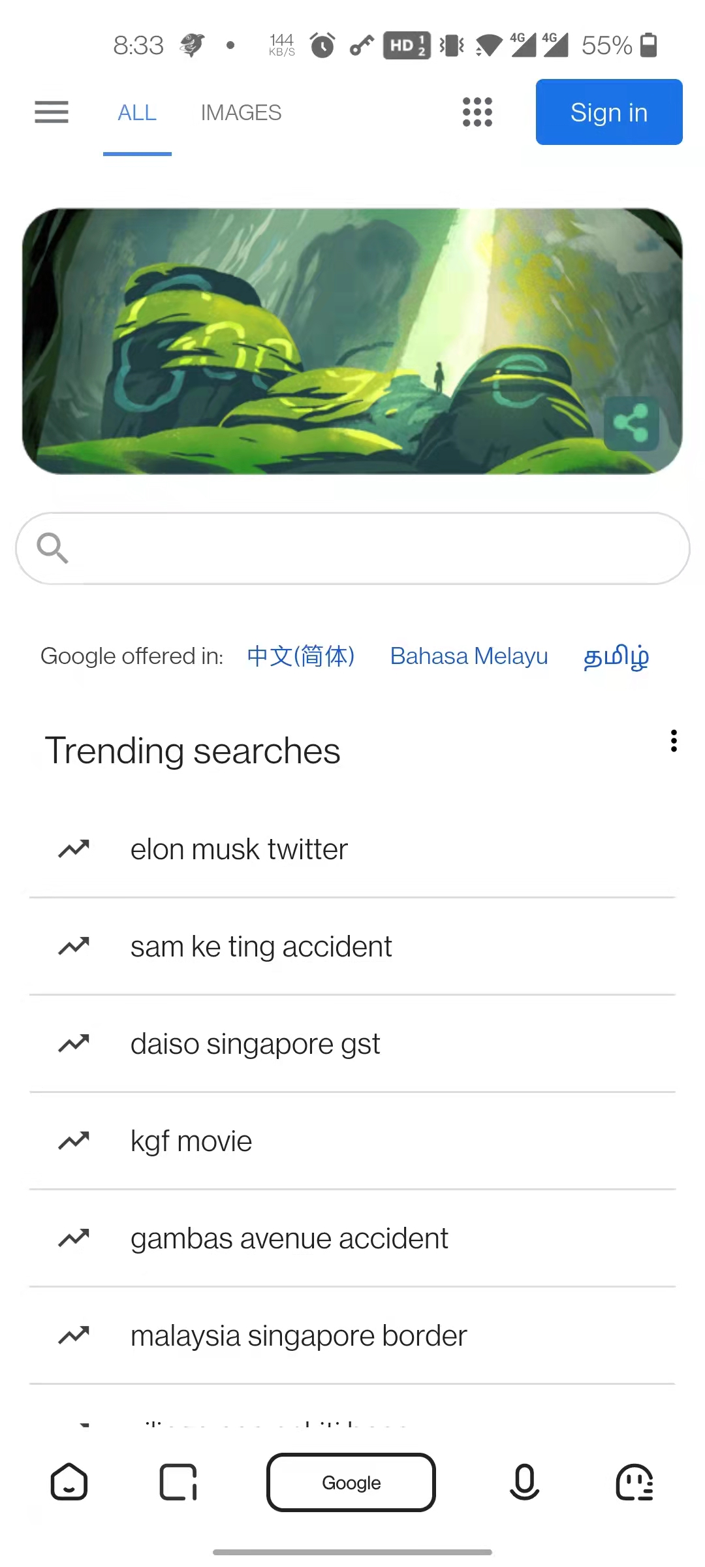
WeBugs seriously affect users’ experience
Program crash
Abnormal function
Abnormal display

Slide 16
Understanding and detecting WeBugs
First empirical study on WeBugs
RQ1: Root cause
RQ2: Fix strategy
Detecting WeBugs
A static analysis tool, WeDetector
Find 11 new bugs in 25 popular WeChat Mini-Programs

Slide 17
Understanding and detecting WeBugs
First empirical study on WeBugs
RQ1: Root cause
RQ2: Fix strategy
Detecting WeBugs
A static analysis tool, WeDetector
Find 11 new bugs in 25 popular WeChat Mini-Programs

Slide 18
WeBug collection
83 WeBugs collected from 3 sources
49 WeBugs
Bugs in which user feedback can be collected
16 WeBugs
Bugs in the development process
18 WeBugs
Bugs in online commercial WeChat Mini-Programs

Slide 19
WeBug collection — GitHub
Step 1
Step 2
Step 3
Keyword search
Repository filter
Bug selection
e.g., Mini-Programs
weapp
wxapp
…
Analyze error stack
source code
discussions
…
Remove invalid &
inactive repositories
255 repositories
4k+ issues
13,365 repositories
49 WeBugs

Slide 20
WeBug collection — developer forum
Step 1
Step 2
QAs collection
Bug selection
Time range:
2021.1.1 – 2021.3.4
Analyze discussions, code, ...
Reproduce some bugs
1w+ Question-Answers
16 WeBugs

Slide 21
WeBug collection — online commercial Mini-Programs
18 WeChat Mini-Programs bugs
Error stack information
Source code of buggy version
Source code of fixed version

Slide 22
Research questions
RQ1: Root cause
What are the root causes of WeChat Mini-Program bugs?
RQ2: Fix strategy
How do developers fix WeChat Mini-Program bugs?
Are there common fix patterns?

Slide 23
RQ1: Root cause
Differences in execution
Logic errors
25%
environments
22%
Asynchronous
errors
API misuse
4%
12%
No verification of
data validity
Syntax errors
19%
18%

Slide 24
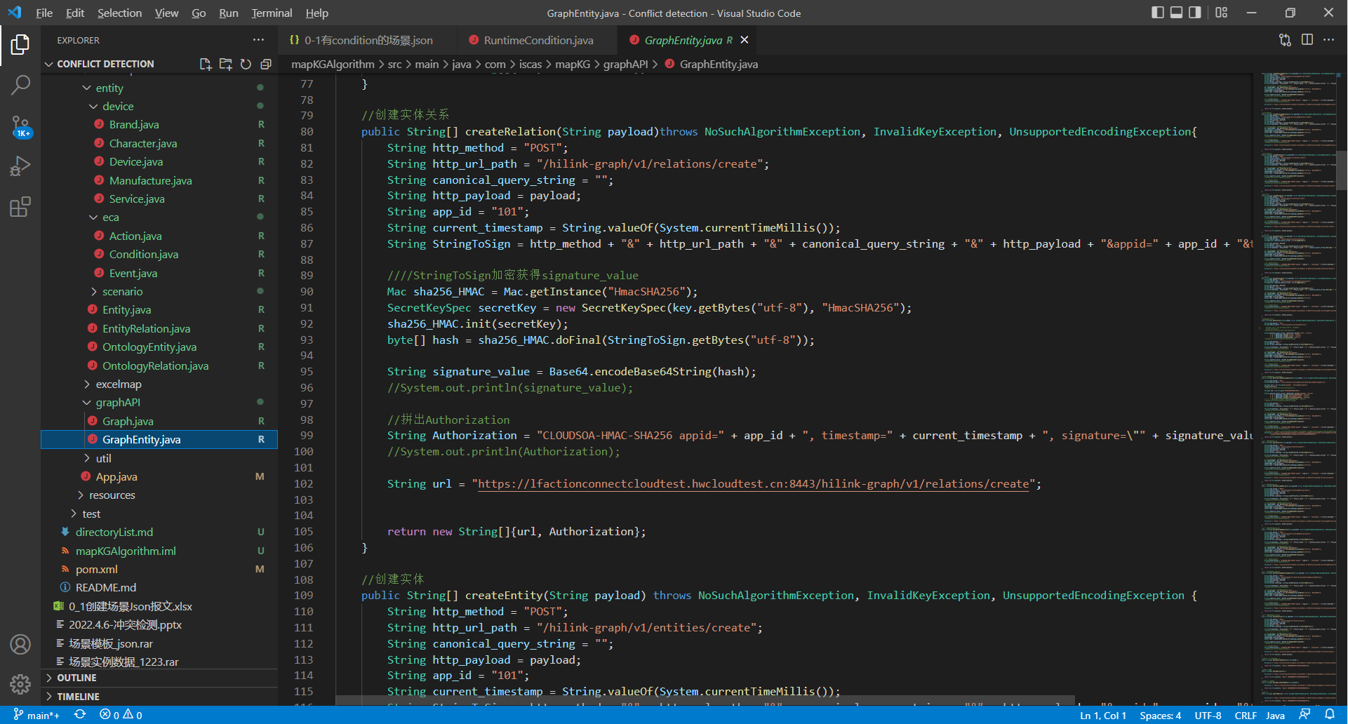
RQ1: Root cause
Difference in execution
environments 22%
Difference in execution environments
Incorrect platform-dependent API invocation
wx.onCompassChange
The accuracy field in the
return data is type of String
parse
The accuracy field in the
return data is type of Integer

Slide 25
RQ1: Root cause
Difference in execution
environments 22%
Difference in execution environments
Incomplete layout adaptation to anomalous screens
The play button of the video is
obscured by the camera

Slide 26
RQ1: Root cause
Difference in execution
environments 22%
Difference in execution environments
Incomplete layout adaptation to anomalous screens
Safe area
Safe area

Slide 27
RQ1: Root cause
No verification of
data validity 19%
No verification of data validity

Slide 28
RQ1: Root cause
No verification of
data validity 19%
No verification of data validity
getList: function(){
request(url, page, function(data)){
var list = data.list;
list.foreach (function(item)){
...
function request(){
wx.request({
url: ...
success: function(res){
return cb(res.data)
},
fail: function (res){
return cb(false)
}
})
}
getList()
request()

Slide 29
RQ1: Root cause
No verification of
data validity 19%
No verification of data validity
getList: function(){
request(url, page, function(data)){
var list = data.list;
list.foreach (function(item)){
...
function request(){
wx.request({
url: ...
success: function(res){
return cb(res.data)
},
fail: function (res){
return cb(false)
}
})
}
getList()
request()
wx.request()

Slide 30
RQ1: Root cause
No verification of
data validity 19%
No verification of data validity
getList: function(){
request(url, page, function(data)){
var list = data.list;
list.foreach (function(item)){
...
function request(){
wx.request({
url: ...
success: function(res){
return cb(res.data)
},
fail: function (res){
return cb(false)
}
})
}
getList()
request()
wx.request()
return cb
…

Slide 31
RQ1: Root cause
No verification of
data validity 19%
No verification of data validity
getList: function(){
request(url, page, function(data)){
var list = data.list;
list.foreach (function(item)){
...
②
function request(){
wx.request({
url: ...
success: function(res){
return cb(res.data)
},
fail: function (res){
return cb(false)
}
})
}
getList()
request()
wx.request()
①
return cb
…
cb.list

Slide 32
RQ1: Root cause
No verification of
data validity 19%
No verification of data validity
getList: function(){
request(url, page, function(data)){
var list = data.list;
list.foreach (function(item)){
...
③
②
function request(){
wx.request({
url: ...
success: function(res){
return cb(res.data)
},
fail: function (res){
return cb(false)
}
})
}
getList()
request()
wx.request()
①
return cb
…
TypeError
cb.list.foreach
cb.list

Slide 33
RQ1: Root cause
Asynchronous error
4%
Asynchronous error
app.onLaunch()
app…()
page.onLoad()
page…()
Application lifecycle functions
Page lifecycle functions
// app.js
var globalData = {...}
onLaunch() {...}
onShow() {...}
...
// page.js
onload() {...}
onShow() {...}
...
Application code
Page code

Slide 34
RQ1: Root cause
userInfo: null
onLaunch()
// app.js
App({
gData: {
userInfo: null
},
onLaunch() {
wx.getUserInfo({
success: res => {
this.Data.userInfo
= res.userInfo
}
…
Application code

Slide 35
RQ1: Root cause
userInfo: null
onLaunch()
wx.getUserinfo
// app.js
App({
gData: {
userInfo: null
},
onLaunch() {
wx.getUserInfo({
success: res => {
this.Data.userInfo
= res.userInfo
}
…
Application code

Slide 36
RQ1: Root cause
userInfo: null
onLaunch()
onLoad()
wx.getUserinfo
// app.js
App({
gData: {
userInfo: null
},
onLaunch() {
wx.getUserInfo({
success: res => {
this.Data.userInfo
= res.userInfo
}
…
// page.js
const app = getApp()
Page({
data: {
userInfo: {},
},
onLoad() {
this.setData({
userInfo: app.gData
.userInfo,
})
Application code
Page code

Slide 37
RQ1: Root cause
userInfo: null
onLaunch()
onLoad()
userinfo: null
userInfo
wx.getUserinfo
// app.js
App({
gData: {
userInfo: null
},
onLaunch() {
wx.getUserInfo({
success: res => {
this.Data.userInfo
= res.userInfo
}
…
// page.js
const app = getApp()
Page({
data: {
userInfo: {},
},
onLoad() {
this.setData({
userInfo: app.gData
.userInfo,
})
Application code
Page code

Slide 38
Research questions
RQ1: Root cause
What are the root causes of WeChat Mini-Program bugs?
RQ2: Fix strategy
How do developers fix WeChat Mini-Program bugs?
Are there common fix patterns?

Slide 39
RQ2: Fix strategy
The fixes of WeBugs are highly related to their root causes
No | Fix pattern | # WeBugs
1 | Layout adaptation to anomalous screens. | 3
2 | Adding undefined/null check before use. | 16
3 | Wait for synchronization. | 3
4 | Fix corresponding syntax errors. | 15
5 | Case by case fixes. | 46
44.6%

Slide 40
RQ2: Fix strategy
Layout adaptation to anomalous screens
Step 1
Step 2
Obtain the safeArea of the
target device by invoking
the API wx.getSystemInfo
Safe area
Set UI styles based on
safeArea

Slide 41
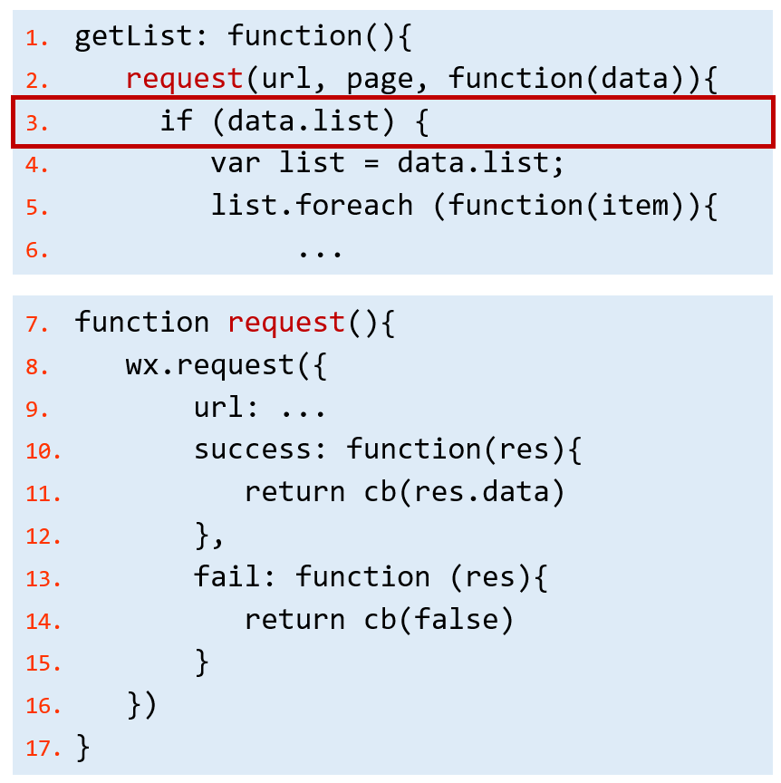
RQ2: Fix strategy
Adding undefined / null check before use
getList()
request()
wx.request
return cb
…
TypeError
cb.list.foreach
cb.list

Slide 42
Understanding and detecting WeBugs
First empirical study on WeBugs
RQ1: Root cause
RQ2: Fix strategy
Detecting WeBugs
A static analysis tool, WeDetector
Find 11 new bugs in 25 popular WeChat Mini-Programs

Slide 43
WeBug detection
Bug patterns
Pattern 1. Incorrect invocations of platform-dependent APIs

Slide 44
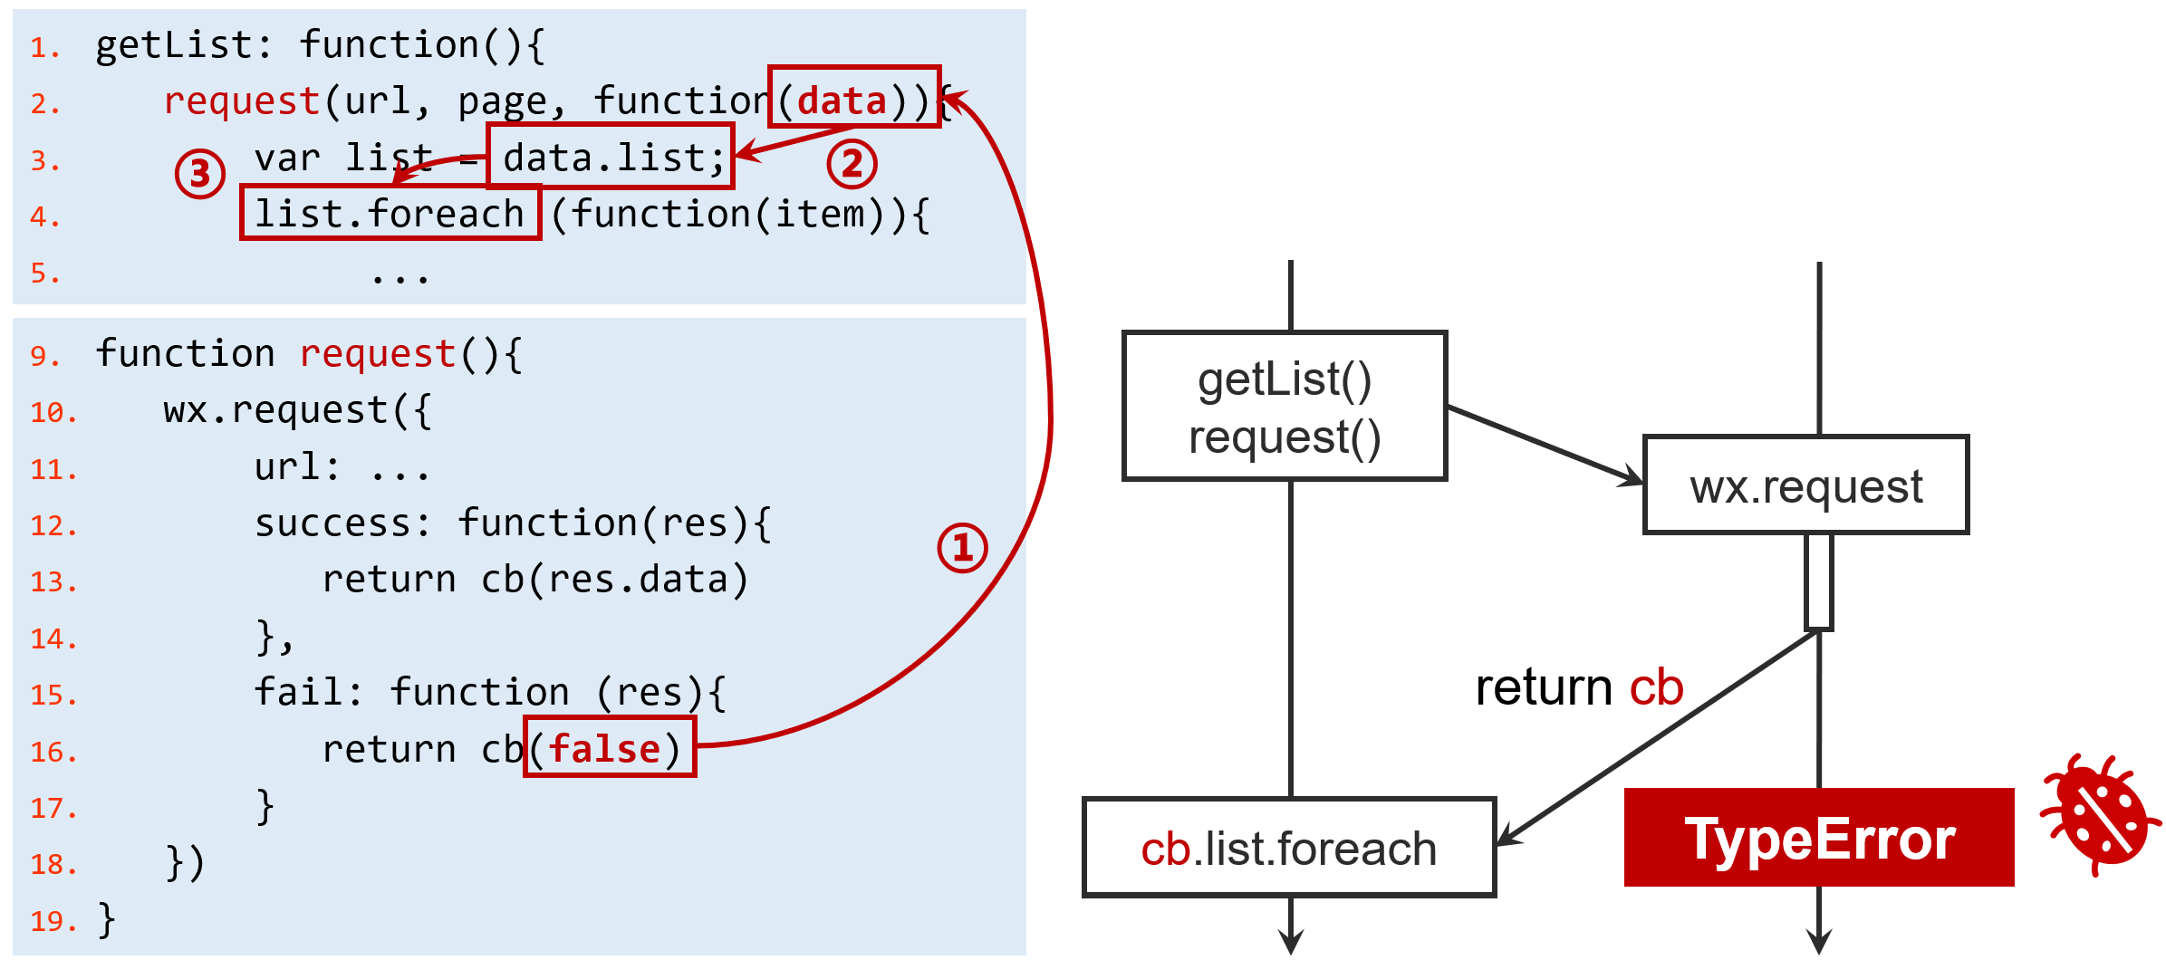
WeBug detection
Bug patterns
Pattern 1. Incorrect invocations of platform-dependent APIs
Pattern 2. Incomplete layout adaptation to anomalous screens
Pattern 3. Improper handling of return data when invoking asynchronous APIs
Safe area

Slide 45
WeDetector
Detect Pattern.1 and Pattern.2
Check whether the developer considers the variety of target devices
Pattern 1. Incorrect invocations of platform-dependent APIs
wx.onCompassChange
If Android: …
wx.getSystemInfo
If iOS: …

Slide 46
WeDetector
Detect Pattern.1 and Pattern.2
Check whether the developer consider the variety of target devices
Pattern 1. Incorrect invocations of platform-dependent APIs
Pattern 2. Incomplete layout adaptation to anomalous screens
Width: 90%
Height: 90%
Width: 0.9*safeArea
Height: 0.9*safeArea
getSafeArea
Safe area

Slide 47
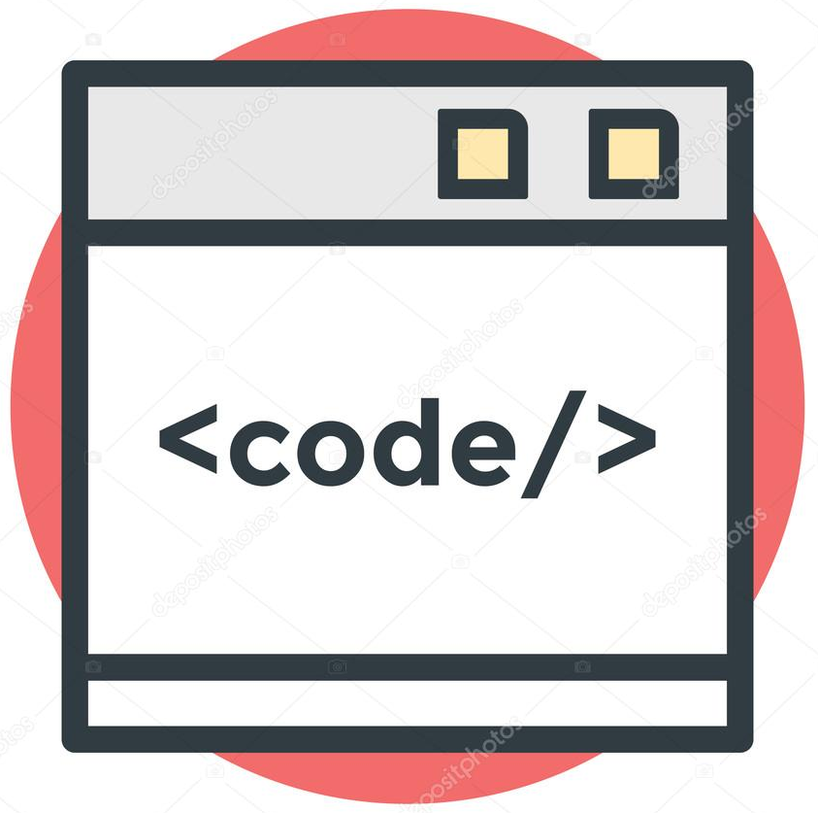
WeDetector
Detect Pattern.3
Check whether the return data is legally used
Pattern 3. Improper handling of return data in invoking asynchronous APIs
source code
AST
locating callback data
usage analysis

Slide 48
Evaluation
RQ: Can WeDetector detect new WeBugs in real-world Mini-Programs?
Experimental subjects
25 WeChat Mini-Programs
13 latest versions of Mini-Programs
from our WeBug study
12 popular Mini-Programs
covering different domains

Slide 49
Evaluation result
WeDetector detects 11 true WeBugs, and 7 of them have been confirmed
Project | Category | Detection Results |  |  |  | Total (Conf.)
 |  | P1 | P2 | P3 | FP
wxchat-mail | Email | 0 | 1 | 0 | 0 | 1 (1)
HITMers | Attendance | 0 | 1 | 0 | 0 | 1 (1)
super | Video | 0 | 1 | 0 | 0 | 1 (1)
leantodo-weapp | Notebook | 0 | 1 | 0 | 0 | 1 (1)
taro-music | Music | 0 | 1 | 0 | 0 | 1 (1)
weapp-mark | Social | 0 | 1 | 0 | 1 | 0 (0)
nideshop | Shopping | 2 | 0 | 0 | 0 | 2 (0)
Gitter | Git | 0 | 1 | 0 | 0 | 1 (0)
pinche | Travelling | 0 | 0 | 1 | 0 | 1 (0)
we-app-ssha | News | 2 | 0 | 0 | 0 | 2 (2)
Total |  | 4 | 7 | 1 | 1 | 11 (7)

Slide 50
Evaluation result
WeDetector detects 11 true WeBugs, and 7 of them have been confirmed
Project | Category | Detection Results |  |  |  | Total (Conf.)
 |  | P1 | P2 | P3 | FP
wxchat-mail | Email | 0 | 1 | 0 | 0 | 1 (1)
HITMers | Attendance | 0 | 1 | 0 | 0 | 1 (1)
super | Video | 0 | 1 | 0 | 0 | 1 (1)
leantodo-weapp | Notebook | 0 | 1 | 0 | 0 | 1 (1)
taro-music | Music | 0 | 1 | 0 | 0 | 1 (1)
weapp-mark | Social | 0 | 1 | 0 | 1 | 0 (0)
nideshop | Shopping | 2 | 0 | 0 | 0 | 2 (0)
Gitter | Git | 0 | 1 | 0 | 0 | 1 (0)
pinche | Travelling | 0 | 0 | 1 | 0 | 1 (0)
we-app-ssha | News | 2 | 0 | 0 | 0 | 2 (2)
Total |  | 4 | 7 | 1 | 1 | 11 (7)
False positive

Slide 51
Evaluation result
False positive
False positive
// style.wxss
.iphonex-bottom-holder {
padding-bottom: env(safe-area-inset-bottom);
padding-bottom: constant(safe-area-inset-bottom);
}
...
The developer defines the adaptation code in the wxss file
WeDetector detects WeBugs based on the analysis of JS code

Slide 52
Conclusion
First empirical study of WeChat Mini-Program bugs
83 WeBugs from three sources
Investigate their root causes and fix strategies
A static analysis tool, WeDetector, to detect WeBugs
Detect 11 new WeBugs in 25 Mini-Programs, and 7 of them have been confirmed
More details on GitHub
https://github.com/tcse-iscas/WeBug

