Slide 1
44th International Conference on Software Engineering
Knowledge-Based Environment Dependency Inference for Python Programs
Hongjie Ye, Wei Chen, Wensheng Dou, Guoquan Wu, Jun Wei
Notes:
Hello everyone. I’m Yehongjie, from Institute of Software, Chinese Academy of Sciences. Today I will introduce our paper entitled Knowledge-Based Environment Dependency Inference for Python Programs

Slide 2
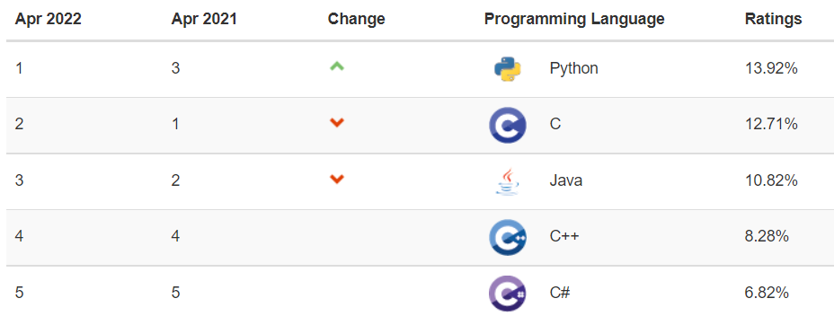
Python - A Popular Programming Language
[1] https://www.tiobe.com/tiobe-index/
Notes:
Python is one of the most popular programming languages, and it is widely used in many application fields

Slide 3
Thriving and Active Python Ecosystem
360,000+ Packages until 2022-04-01
An average of about 200 new packages per day
[1] http://www.modulecounts.com
[2] https://pypi.org/
Notes:
Python has the thriving and active ecosystem. PyPI is the 2nd most fast-growing package repository. It hosts over 3 hundred thousand packages and increases an average of about 2 hundred new packages per day

Slide 4
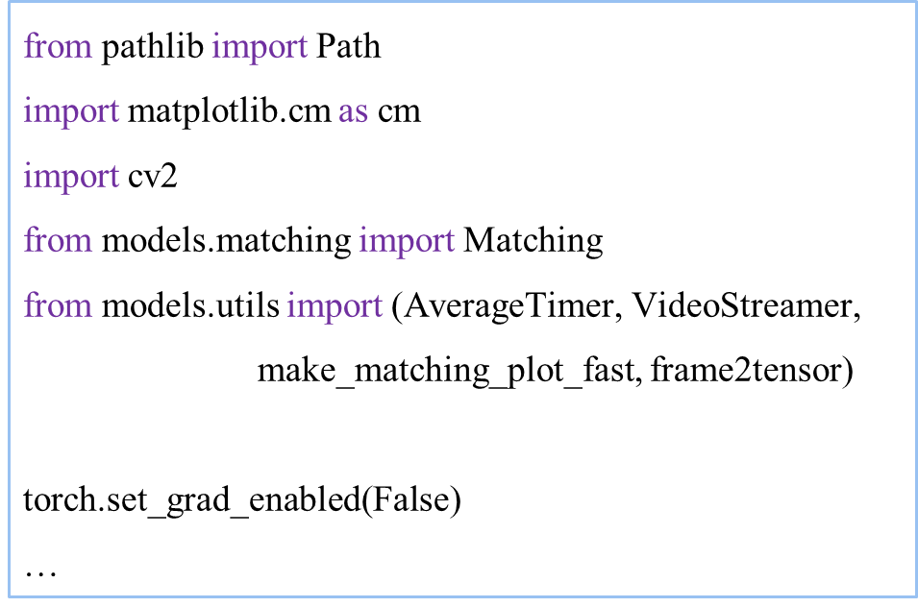
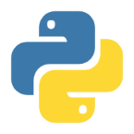
Python Code Reuse
I want to find all <….> in <>.
source code without dependencies
python demo_superglue.py
SyntaxError
ImportError
demo_superglue.py
Notes:
Thus, people usually reuse Python code to improve development efficiency.
For example, someone wants to find all Tom cats in the movie, and he search stack overflow and gist for reusable code snippets.
He gets a code snippet, demo superglue, but the source code is provided without its dependencies.
Finally, he runs the source code but encounters SyntaxError and ImportError.

Slide 5
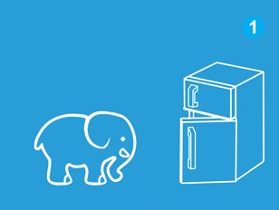
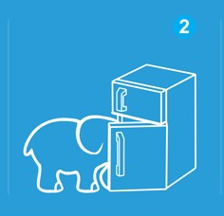
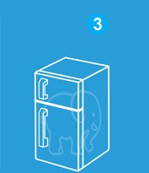
Three Steps to Reuse a Python Program
① Choose a compatible Python version
② Determine and install dependent third-party packages
③ Run it!
Notes:
It seems easy to run program containing the reused code snippet.
The user can first install a compatible version of the Python interpreter, and then install all the dependent Python third-party packages.
After that, the user can run the program.

Slide 6
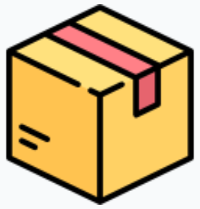
Task 1: Install a Compatible Python Version
requires (>=3.5)
import
Python
pathlib
1
2
3
4
5
6
7
8
9
from pathlib import Path
import matplotlib.cm as cm
import cv2
from models.matching import Matching
from models.utils import (AverageTimer, VideoStreamer,
make_matching_plot_fast, frame2tensor)
torch.set_grad_enabled(False)
…
Standard modules are intrinsically contained in the Python interpreter.
Pathllib is a standard module contained in Python 3.5 or above
code snippet of demo_superglue.py
Notes:
However, inferring dependencies for Python programs is non-trivial. Take the following code snippet, demo superglue, as an example.
Firstly, demo superglue imports pathlib in line 1. Pathlib is a standard module, and all standard modules are contained in the Python interpreter.
Pathlib is contained in Python 3.5 or above, which restricts the compatible Python versions of demo superglue.

Slide 7
Task 2: Install Dependent Third-Party Packages
in
matplotlib
matplotlib
import
1
2
3
4
5
6
7
8
9
from pathlib import Path
import matplotlib.cm as cm
import cv2
from models.matching import Matching
from models.utils import (AverageTimer, VideoStreamer,
make_matching_plot_fast, frame2tensor)
torch.set_grad_enabled(False)
…
in
import
opencv-python
cv2
Third-party modules are contained in third-party packages.
Module names can be inconsistent with package names.
code snippet of demo_superglue.py
Notes:
Secondly, demo superglue imports matplotlib in line 2. matplotlib is a third party module contained in the third-party package matplotlib.
And in line 3, demo superglue imports cv2, another third-party module contained in opencv-python.
We can find that module names are not always consistent with package names.

Slide 8
Task 3: Install Dependent System Libraries
1
2
3
4
5
6
7
8
9
from pathlib import Path
import matplotlib.cm as cm
import cv2
from models.matching import Matching
from models.utils import (AverageTimer, VideoStreamer,
make_matching_plot_fast, frame2tensor)
torch.set_grad_enabled(False)
…
in
import
opencv-python
cv2
depends on
libopencv-contrib
Third-party packages may depend on system libraries.
code snippet of demo_superglue.py
Notes:
Thirdly, opencv-python depends on a system library, libopencv-contrib. We should install it before using the package.

Slide 9
Task 4: Avoid Potential Version Constraint Violations
>=1.19.3
opencv-python
4.4.0.46
Different constraints
numpy
>=1.15
Different packages may depend on the same resource (a package or the interpreter) with different version constraints.
matplotlib 3.3.3
Notes:
Lastly, a package can be required by others at the same time with different version constraints.
Therefore, users should carefully choose a proper package version to avoid potential version constraint violations.
For example, matplotlib 3.3 requires numpy not lower than 1.15, while opencv-python 4.4 requires numpy not lower than 1.19.
It is necessary to choose a version later than 1.19, to satisfy both version constraints.

Slide 10
Related Work
DockerizeMe^{[1]} , Pipreqs^{[2]}, SnifferDog^{[3]}
 | Third-party packages | The Python interpreter | System libraries | Constraints among dependencies
pipreqs | √ | × | × | ×
DockerizeMe | √ | × | √⁻ | ×
SnifferDog | √ | × | × | ×
[1] HORTON E, PARNIN C. Dockerizeme: Automatic inference of environment dependencies for python code snippets; ICSE 2019.
[2] https://github.com/bndr/pipreqs
[3] Wang J, Li L, Zeller A. Restoring Execution Environments of Jupyter Notebooks; ICSE 2021.
Notes:
DockerizeMe, pipreqs And SnifferDog are three most related work for inferring dependencies of Python programs. They mainly focus on dependencies of Python third-party packages. However, they pay no attention to the Python interpreter version, and pay little attention to dependent system libraries. Moreover, none of them consider the interrelations among the dependencies.

Slide 11
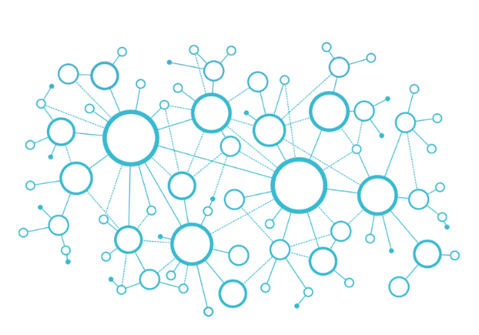
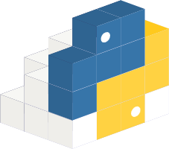
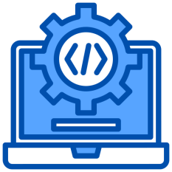
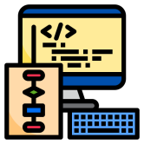
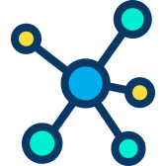
Approach Overview
A knowledge-based approach to infer dependencies for Python programs
Stage 1: construct Python domain knowledge graph (PyKG)
Stage 2: infer dependencies for Python programs (PyEGo)
Knowledge Extraction & Mining
Python knowledge graph (PyKG)
Multiple Data sources
Program Analysis
Constraint Solving
Target Python program
Program features
Dependency candidates
Runtime environment
Notes:
As comprehensive knowledge is required for constructing a compatible environment for Python programs, we are motivated to propose a knowledge-based approach to infer dependencies for Python programs.
First, we collect and extract domain knowledge from multiple data source,
and construct a knowledge graph PyKG, which can portray the relations among third-party packages, the Python interpreter, and system libraries.
Then, we propose a knowledge-based environment dependency inference technique PyEGo.
Given a target Python program, PyEGo first extracts its features,
and then infers dependencies of the three types for the program with the support of the constructed knowledge base.

Slide 12
Stage 1: Construct Python Domain Knowledge Graph
Basic entities in knowledge graph model
Python interpreter
Third-party package
System library
Notes:
Let’s begin with knowledge graph model design. The three types of dependencies, packages, libraries, and the interpreter, are considered as the basic elements of the graph model.

Slide 13
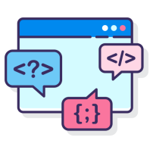
Stage 1: Construct Python Domain Knowledge Graph
Features of the Python interpreter
Syntax feature
Python interpreter
Standard module
Third-party package
System library
Features of dependency resources
Notes:
Python interpreters support various syntax features, and contain multiple standard modules.

Slide 14
Stage 1: Construct Python Domain Knowledge Graph
Features of Python third-party packages
Syntax feature
Python interpreter
Standard module
Third-party module
Third-party package
System library
Features of dependency resources
Notes:
Third-party packages are identified by their contained third-party modules. Red edges between nodes describe the relations between features and the dependency resources.

Slide 15
Stage 1: Construct Python Domain Knowledge Graph
Dependencies between packages and libraries
Syntax feature
Python interpreter
Standard module
Third-party module
Third-party package
System library
Features of dependency resources
Dependencies between 3rd-party package and system library
Notes:
Meanwhile, the knowledge graph records dependencies between packages and libraries.

Slide 16
Stage 1: Construct Python Domain Knowledge Graph
Other interrelations among dependency resources
Syntax feature
Python interpreter
Standard module
Third-party module
Third-party package
System library
Features of dependency resources
Interrelations among dependency resources
Notes:
It also portrays dependencies among packages, and Compatibilities between the interpreter and packages. Blue edges are interrelations among dependency resources.

Slide 17
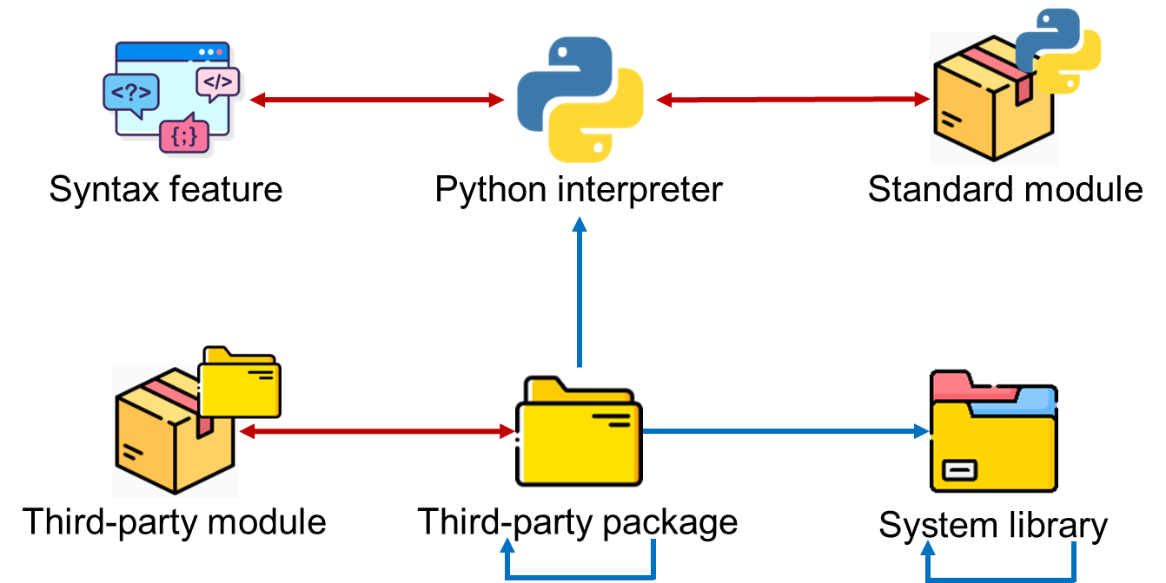
Extract Supported Syntax Features of Python Versions
Analyze “new features” section of Python documents
Identify context-free syntax features
Transform them into regular expressions
def \S*\(.*, ?/.*\)
Notes:
Based on the knowledge graph model, we organize knowledge collected and extracted from multiple sources.
We obtain the knowledge of what syntax features are supported by each Python versions.
To this end, we summarize context-free syntax features of Python versions and transform them into regular expressions. For example, Positional-only parameters is such a syntax feature, and we convert it to a regular expression. The obtained regular expressions are further used for identifying the compatible Python versions.

Slide 18
Extract Modules in Interpreter and Packages
Traverse directories and files in a package
Python files are modules
Folders containing __init__.py are modules
# opencv-python 4.4.0.46
.
├── cv2
│ ├── data
│ ├── version.py
│ ├── __init__.py
│ └── ……
└── opencv_python-4.4.0.46.dist-info
opencv-python 4.4.0.46
cv2
cv2.version
Notes:
Then, we collect the knowledge of what modules are contained in each Python interpreter and third-party packages.
We analyze the directory structure to extract modules in different levels. Python files are modules, and folders containing init file are also modules.
For example, cv2 is a top-level module contained in opencv-python, and cv2 dot version is a second-level module.

Slide 19
Extract Compatibilities
Analyze metadata files in packages
Extract compatibilities between 3rd-party packages and Python interpreters from Requires-Python filed
# opencv-python 4.4.0.46
.
├── cv2
│
└── opencv_python-4.4.0.46.dist-info
├── LICENSE.txt
├── METADATA
├── top_level.txt
└── ……
Python 3.9
Python 3.6
Metadata-Version: 2.1
Name: opencv-python
Version: 4.4.0.46
License: MIT
Requires-Python: >=3.6
Requires-Dist: numpy (>=1.19.3)
… …
opencv-python 4.4.0.46
Notes:
After that, we analyze metadata files of a 3rd-party package for obtaining the combability between the package and Python interpreters
For example opencv-python requires python not lower than 3.6. Thus, it is compatible with Python 3.6 and 3.9

Slide 20
Extract Dependencies between 3rd-party packages
Analyze metadata files in packages
Extract dependencies between 3rd-party packages from Requires-Dist filed
# opencv-python 4.4.0.46
.
├── cv2
│
└── opencv_python-4.4.0.46.dist-info
├── LICENSE.txt
├── METADATA
├── top_level.txt
└── ……
Python 3.9
Python 3.6
Metadata-Version: 2.1
Name: opencv-python
Version: 4.4.0.46
License: MIT
Requires-Python: >=3.6
Requires-Dist: numpy (>=1.19.3)
… …
opencv-python 4.4.0.46
numpy 1.19.3
Notes:
We also analyze the metadata for obtaining the dependencies between 3rd-paty packages.
For example opencv-python requires numpy not lower than 1.19. Thus it depends on numpy 1.19.3.

Slide 21
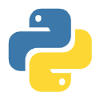
Mining Package - Library Dependencies
Not documented explicitly
Mining associations from Dockerfiles
Similarity-based mining with apt python lib distributions
① Find similar packages in pip and apt
opencv-python (pip)
cv2
Similar package name
Same top-level module
(SimName+SimModule)/2 > threshold
python-opencv (apt)
cv2
Notes:
Dependencies between system libraries and Python third-party packages are not explicitly documented.
To obtain more comprehensive knowledge of what system libraries are required by a certain package, we propose a similarity based mining method in addition to the association rule mining method proposed by DockerizeMe.
We noticed that some pip-installable third-party packages have similar apt-installable distributions with slight differences in their names and structures,

Slide 22
Mining Package - Library Dependencies (Cont.)
Not documented explicitly
Mining associations from Dockerfiles
Similarity-based mining with apt python lib distributions
② Query apt python distribution dependency
Depends on
apt-cache depends
python-opencv (apt)
libopencv-contrib
Notes:
and the system-level dependencies of apt-installable distributions can be obtained through executing the apt command.

Slide 23
Mining Package - Library Dependencies (Cont.)
Not documented explicitly
Mining associations from Dockerfiles
Similarity-based mining with apt python lib distributions
③ Infer dependency relation
Depends on
opencv-python (pip)
Depends on
python-opencv (apt)
libopencv-contrib
Notes:
Thus, if an apt-installable package depends on a set of system libraries, it is high likely that the similar pip-installable one depends on those system libraries, too.

Slide 24
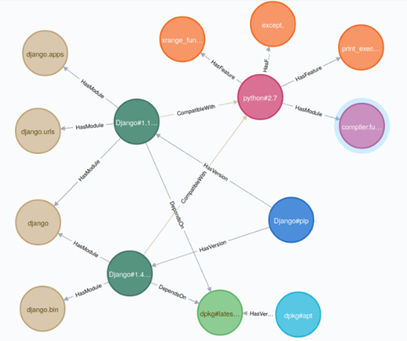
PyKG - Python Domain Knowledge Graph
251,740 nodes
1,644,388 relations
19 syntax features
674 standard modules
50,770 system packages
16,156 Python packages
65,147 versions of Python packages
68,198 3rd-party modules
1,220,351 dependency relationships
Notes:
Finally, we analyzed over 10 thousands of third party packages and 6 versions of the Python interpreter, and constructed a knowledge graph containing hundreds of thousands of entities and millions of relations.

Slide 25
Approach Overview
A knowledge-based approach to infer dependencies for Python programs
Stage 1: construct Python domain knowledge graph (PyKG)
Stage 2: infer dependencies for Python programs (PyEGo)
Knowledge Extraction & Mining
Python knowledge graph (PyKG)
Multiple Data sources
Program Analysis
Constraint Solving
Target Python program
Program features
Dependency candidates
Runtime environment
Notes:
In stage 2, we propose an approach to infer dependencies for Python programs.
Given a target Python program, PyEGo first extracts its features, and then it queries the knowledge graph with the features to get the dependency candidates, finally, it infers appropriate dependencies of the three types for the program through constraint solving.

Slide 26
Extract Program Features
Identify imported modules based on program analysis
Parse each Python file into AST (Abstract Syntax Tree)
Identify modules from import nodes
Module features
Standard modules
from pathlib import Path
import cv2
import matplotlib.cm as cm
from models.utils import AverageTimer
…
if opt.output_dir is not None:
stem = f ’matches_{stem0}_{stem1}’
out_file = str(Path(opt.output_dir, stem+’.png’))
print(f ’Writing image to {out_file}’)
…
pathlib
pathlib.Path
Third-party modules
cv2
matplotlib
matplotlib.cm
Local modules
models
models.utils
Notes:
To extract features of the program, we first parse each Python file into AST, and then identify modules from Import nodes.
For example, by analyzing line 1, we can find that the code snippet imports a top-level module pathlib, and a second-level module pathlib dot Path.
Then we query PyKG and classify modules into standard modules, third-party modules and local modules.
For example, pathlib is a standard module, and cv2 and matplotlib are third-party modules.
Finally, we take standard modules and third-party modules as module features.

Slide 27
Extract Program Features
Identify used syntax features by matching the program against regular expressions
from pathlib import Path
import cv2
import matplotlib.cm as cm
from models.utils import AverageTimer
…
if opt.output_dir is not None:
stem = f ’matches_{stem0}_{stem1}’
out_file = str(Path(opt.output_dir, stem+’.png’))
print(f ’Writing image to {out_file}’)
…
Syntax features
Formatted string literals (f-string)
Regex: f\’.*{.+}.*\’
Notes:
On the other hand, we extract syntax features by matching program code against syntax features in the form of regular expressions.
For example, PyEGo identifies that the code snippet used a syntax feature f-string.

Slide 28
Identify Dependency Candidates
Query PyKG
Get Python candidates with identified standard modules and syntax features
Python 3.6
f-string
pathlib
Python 3.9
pathlib.Path
Notes:
Then, we query PyKG for dependency candidates. We query candidate Python versions with standard modules and syntax features.
For example, we find Python 3.6 and 3.9 both contained the standard modules pathlib and pathlib dot Path, and they both support the syntax feature f-string.

Slide 29
Identify Dependency Candidates
Query PyKG
Get package candidates with imported third-party modules
opencv-python 3.1
Python 3.6
matplotlib 2.2
matplotlib
cv2
opencv-python 4.4
Python 3.9
matplotlib 3.3
matplotlib.cm
Notes:
We query candidate packages with third-party modules.
Opencv-python 3.1 and 4.4 contain the third-party module cv2. Matplotlib 2.2 and 3.3 both contained the third-party modules matplotlib and matplotlib dot cm.

Slide 30
Identify Dependency Candidates
Query PyKG
Get transitive dependency candidates with direct dependency candidates
opencv-python 3.1
Python 3.6
matplotlib 2.2
libopencv-contrib
pytz 2022.1
opencv-python 4.4
Python 3.9
matplotlib 3.3
numpy 1.9
pillow 8.0
Notes:
Then, we get their transitive dependent packages and system libraries.
Matplotlib depends on pytz and pillow. Opencv-python depends on numpy, and depends on a system library libopencv-contrib.

Slide 31
Identity Dependency Candidates
Generate target program-centric subgraph
Identify interrelations among candidates
opencv-python 3.1
Python 3.6
matplotlib 2.2
libopencv-contrib
pytz 2022.1
opencv-python 4.4
Python 3.9
matplotlib 3.3
numpy 1.9
pillow 8.0
Notes:
Finally, candidates form a target program centric subgraph. Nodes in the subgraph are versions of dependency candidates, and edges are interrelations among them.
This slide presents a part of the subgraph of the exemplary code snippet.

Slide 32
Infer Dependencies
Determine candidate versions via constraint solving
① Existence constraints: Direct dependencies must be installed
opencv-python 3.1
Python 3.6
matplotlib 2.2
libopencv-contrib
pytz 2022.1
opencv-python 4.4
Python 3.9
matplotlib 3.3
If matplotlib 2.2 is selected, pillow 8.0 is not necessary
numpy 1.9
pillow 8.0
Notes:
Then, we determine versions of candidates via constraint solving. To avoid dependency conflicts, we propose 3 constraints. The first one, existence constraint means the Python interpreter and direct dependent packages are necessary and must be installed. For example, opencv-python is a direct dependency, and we must install a proper version of it.

Slide 33
Infer Dependencies
Determine candidate versions via constraint solving
② Unique constraints: One version can be installed
opencv-python 3.1
Python 3.6
matplotlib 2.2
libopencv-contrib
pytz 2022.1
opencv-python 4.4
Python 3.9
matplotlib 3.3
Only one version of matplotlib can be installed
numpy 1.9
pillow 8.0
Notes:
The second one, unique constraint means at most one version of each resource can be installed. For example, one can install matplotlib 2.2 or 3.3, but cannot install both at the same time.

Slide 34
Infer Dependencies
Determine candidate versions via constraint solving
opencv-python 3.1
Python 3.6
matplotlib 2.2
libopencv-contrib
pytz 2022.1
opencv-python 4.4
Python 3.9
matplotlib 3.3
Matplotlib 3.3 is not compatible with Python 3.6
③ Version constraints: versions installed should not violate dependency constraints
numpy 1.9
pillow 8.0
Notes:
And the last one, version constraint means each installed package version should be compatible with any others depending on it. For example, one cannot install Python 3.6 and matplotlib 3.3 at the same time, because they are incompatible with each other.

Slide 35
Infer Dependencies
Optimize feasible solutions
① Install versions as new as possible
opencv-python 3.1
Python 3.6
matplotlib 2.2
libopencv-contrib
pytz 2022.1
opencv-python 4.4
Python 3.9
matplotlib 3.3
Matplotlib 3.3 is preferred than matplotlib 2.2
numpy 1.9
pillow 8.0
Notes:
And to archive the best solution, we propose two requirements. The first one is Install packages with versions as new as possible.
For example, if matplotlib 2.2 and 3.3 are both OK, matplotlib 3.3 is preferred.

Slide 36
Infer Dependencies
Optimize feasible solutions
② Install packages as few as possible
opencv-python 3.1
Python 3.6
matplotlib 2.2
libopencv-contrib
pytz 2022.1
opencv-python 4.4
Python 3.9
matplotlib 3.3
If matplotlib 3.3 is selected, pytz 2022.1 is not necessary.
numpy 1.9
pillow 8.0
Notes:
and the second one is Install packages as few as possible. For example, If matplotlib 3.3 is selected, pytz is not necessary.

Slide 37
Infer Dependencies
Optimize feasible solutions
libopencv-contrib
opencv-python 4.4
Python 3.9
matplotlib 3.3
numpy 1.9
pillow 8.0
Notes:
To this end, PyEgo solves the constraints with an optimization objective.
After constraint solving, the final solution contained proper versions of packages, libraries and the Python interpreter need to be installed

Slide 38
Evaluation
Research questions
RQ1: How effective is PyEGo in inferring dependencies for Python programs?
RQ2: How efficient is PyEGo in inferring dependencies for Python programs?
RQ3: Can PyEGo outperform prior works?
Notes:
To evaluate the effeteness and efficiency of PyEGo, we propose the following three research questions
How effective is PyEGo in inferring dependencies for Python programs?
How efficient is PyEGo in inferring dependencies for Python programs?
And How does PyEGo perform compared to prior work?

Slide 39
Datasets
Distribution of project functions
Existent datasets
HG2.9K: 2,891 gist used by DockerizeMe
JPD: 4,836 Jupyter notebooks listed by SnifferDog
New dataset
SD: 100 Python projects collected from Github
Executable – Has runnable test cases
Explicit – Declared dependencies explicitly
Diverse – Covers many fields
Project statistic
 | AVG | MAX | MIN
Python files | 58 | 1364 | 1
LOC | 10820 | 199833 | 39
Import lines | 269 | 7755 | 0
Notes:
We evaluate PyEGo on three dataset, HG, SD and JPD. HG is a dataset used in the previous work, and JPD contains Jupyter notebooks listed by SnifferDog. To evaluate whether our approach can be used in more complex scenarios, we collected 100 Python projects from github and create an extra dataset SD. Projects in SD are executable, explicit and diverse.

Slide 40
Effectiveness & Efficiency
Accuracy: 46% on HG2.9K, 62% on SD, 61% on JPD
Execution Time: 0.7s on HG2.9K, 2.5s on SD, 2.9s on JPD
 | Total Solved | Accuracy | Avg. Installed Packages | Avg. Installed Python Packages | Avg. Execution Time(s)
HG2.9K | 1334 | 46.14% | 3.71 | 1.41 | 0.69
SD | 62 | 62.00% | 8.91 | 4.01 | 2.52
JPD | 2945 | 60.90% | 8.51 | 3.30 | 2.86
Notes:
Here is the experimental results. Our work, PyEGo, reached 46%, 62% and 60% accuracy on the three dataset, respectively. As for execution time, PyEGo reached 0.7, 2.5 and 2.9 second per project on the three dataset.

Slide 41
Dependency Inference Failure Root Cause Analysis
Missing dependencies (54/100)
Incompatible dependencies (31/100)
Incompatible OS (11/100)
Conditional dependency (4/100)
Missing the extra dependency “xlrd” of BeautifulSoup4
from bs4 import BeautifulSoup
…
# depends on xlrd
soup = BeautifulSoup(r.content, ‘lxml’)
Depends on Python2 and Python3 conditionally
try:
import cPickle as pickle # Python2 module
except ImportError:
import pickle # Python3 module
Notes:
PyEGo failed to infer dependencies for all the programs because of missing dependencies, incompatible dependencies, incompatible OS and conditional dependency.
This is a example of missing extra dependencies. Xlrd is an extra dependency of BeautifulSoup4, and would not be installed automatically. As a result, the code snippet encounter runtime failure because of missing xlrd.
And this is a example of conditional dependency. The program conditionally declares its dependencies on standard modules specific to Python2 and Python3 in a try-catch block. We does not consider the context of import statements and cannot find a Python version containing both modules.

Slide 42
Comparison with Prior Works
Compare with pipreqs and DockerizeMe in term of effectiveness
 | Tools | Total Solved | Accuracy | Avg. Installed Packages | Avg. Installed Python Packages
HG2.9K | PyEGo | 1334 | 46.14% | 3.71 | 1.41
 | pipreqs | 297 | 10.27% | 1.52 | 1.52
 | DockerizeMe | 892 | 30.85% | 7.32 | 5.99
SD | PyEGo | 62 | 62.00% | 8.91 | 4.01
 | pipreqs | 45 | 45.00% | 6.25 | 6.25
 | DockerizeMe | 23 | 23.00% | 13.18 | 10.41
JPD | PyEGo | 2945 | 60.90% | 8.51 | 3.30
 | pipreqs | 2559 | 52.92% | 3.41 | 3.41
 | DockerizeMe | 2234 | 46.20% | 8.48 | 6.86
More effective than pipreqs (3.5x, 0.4x and 0.2x) and DockerizeMe(0.5x, 1.7x and 0.3x)
Infers the least third-party packages.
Infers more system libraries
Notes:
As for research question 3, we compare our work with pipreqs and DockerizeMe. We do not compare it with SnifferDog, because its repository do not offer the critical component, API-bank.
Comparing to pipreqs and DockerizeMe, PyEGo reaches the highest accuracy on the three dataset, and infers the least third-party packages. However, PyEGo infers more system libraries because the obtained dependencies between libraries and packages may be false positive.

Slide 43
Comparison with Prior Works
Compare with pipreqs and DockerizeMe in term of efficiency
 | Tools | Avg. Execution Time(s)
HG2.9K | PyEGo | 0.69
 | pipreqs | 2.18
 | DockerizeMe | 13.45
SD | PyEGo | 2.52
 | pipreqs | 2.43
 | DockerizeMe | 10.37
JPD | PyEGo | 2.86
 | pipreqs | 3.11
 | DockerizeMe | 7.97
Faster than DockerizeMe
Caching a part of KG in memory
Faster than pipreqs in general
Stores knowledge locally
A little slower than pipreqs on SD
Pipreqs do not handle SyntaxError
Notes:
As for execution time, PyEGo runs faster than DockerizeMe, because we cached a part of knowledge graph in memory. PyEGo runs faster than pipreqs in general, because we stores knowledge locally, while pipreqs need to query PyPI for versions of packages. PyEGo runs little slower than pipreqs on the whole SD, because pipreqs exits immediately when encountering SyntaxError during feature extraction, but PyEGo tries changing the Python interpreter version to extract its features.

Slide 44
Conclusion
A knowledge-based approach to infer for Python programs
A dependency knowledge graph and its construction approach
A knowledge-based environment dependency inference technique, regarding constraints among a program and its dependencies and can inferring the latest compatible dependency versions of three types
Available at https://github.com/tcse-iscas/PyEGo
Notes:
In conclusion, we proposed a knowledge-based approach to infer dependencies and generate runtime environments for Python programs. The approach contains two stages, knowledge graph construction and runtime environment generation. The experimental results shows that our work is more effective and efficient than the state-of-the-art work. Our work is available on github.

Slide 45
Thanks!
Q & A
yehongjie19@otcaix.iscas.ac.cn
Notes:
That all, thank you.

