Slide 1
Semantic Table Structure Identification in Spreadsheets
ACM SIGSOFT International Symposium on Software Testing and Analysis (ISSTA 2021)
Yakun Zhang, Xiao Lv, Haoyu Dong, Wensheng Dou, Shi Han,
Dongmei Zhang, Jun Wei, Dan Ye
Institute of Software,
Chinese Academy of Sciences
University of Chinese Academy of Sciences
Microsoft Research Asia
Notes:
Hello everyone, I am Yakun Zhang from University of Chinese Academy of Sciences.
It’s my honor to be here and talk about our work: Semantic Table Structure Identification in Spreadsheets.

Slide 2
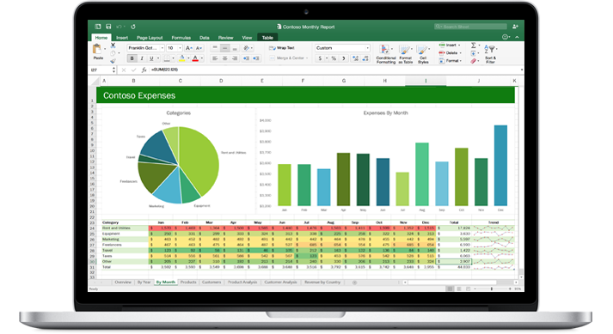
Spreadsheet
Spreadsheets are widely used
Spreadsheet systems: Microsoft Excel, WPS, Google Sheet
More than 50% businesses use spreadsheets [1]
[1] Rethinking Spreadsheets and Performance Management. https://www.cutimes.com/rethinking-spreadsheets-and- performance- management
Notes:
Spreadsheet system such as Microsoft Excel, WPS, and Google sheet are widely used in various business tasks. Existing studies show that there were more than fifty percent （50%） businesses used spreadsheets.

Slide 3
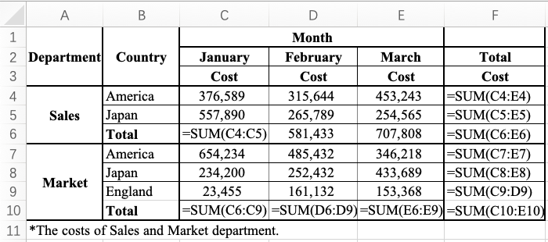
Table
Table: a rectangular block of cells, prescribing certain business task
Element: header region, data region
Table
Header region
Data region
Notes:
The spreadsheet excerpt in the previous example is a table. A table is a rectangular block of cells, prescribing certain business task. A table contains two elements: (click) header region and (click) data region.

Slide 4
Table Structure
Table structure: complex and informal
Example: parent-child relation, sibling relation
Parent-child relation
Sibling relation
Table structure
Notes:
There are multiple complex and informal structures within the table, such as (click) parent-child relation and (click) sibling relation.

Slide 5
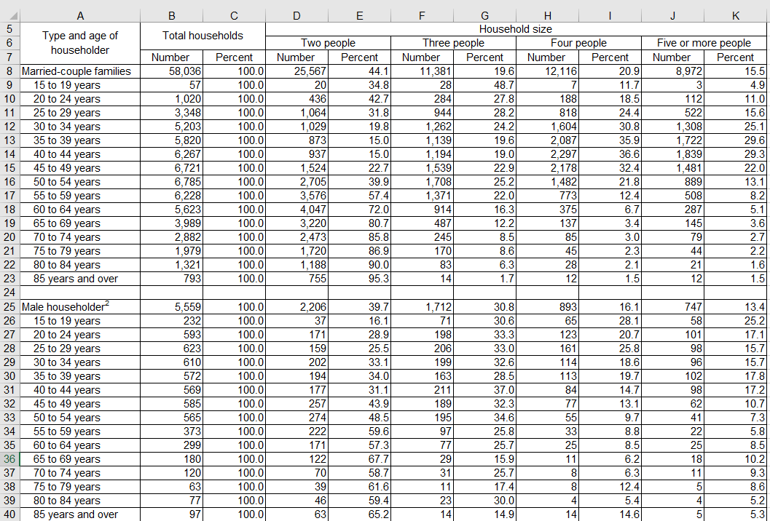
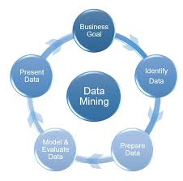
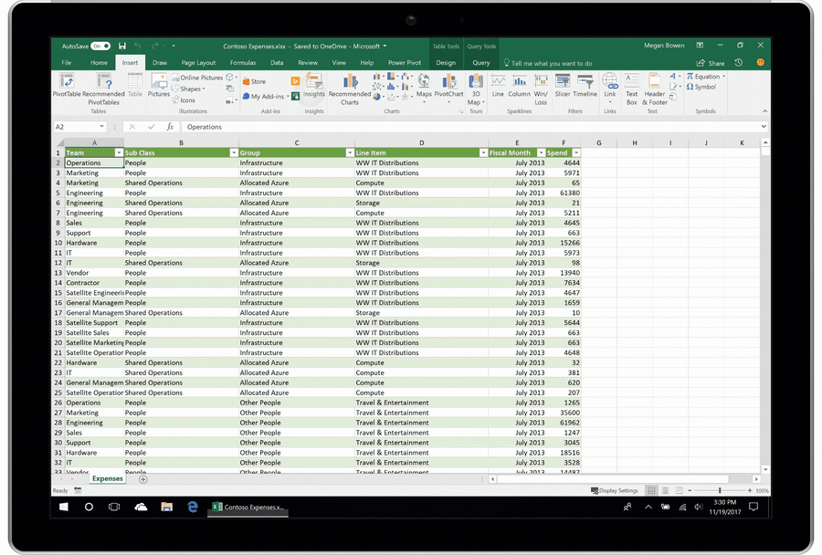
Spreadsheet Data cannot be Fully Utilized
No clear table structures
Data Analysis
Data Mining
Error Detection
Notes:
Since the spreadsheet system does not document clear table structure information, a large number of spreadsheet data is difficult to be applied in data analysis, data mining and error detection.

Slide 6
Research Outline
Semantic table structure model
Semantic table structure identification
Structure-based error detection
Evaluation
Notes:
Therefore, to solve the problem, we firstly construct a semantic table structure model.

Slide 7
Semantic Table Structure
Header type
Index
Value name
Aggregation
Index name
Index
Notes:
Given a spreadsheet table, its semantic table structure describes header types and the relations among headers. We first study the header types. We divide different header types according purposes. For example, the header B8 in the red area indicates the index of the data cells in the blue area. Therefore, B8 is an index header.

Slide 8
Semantic Table Structure
Header type
Index
Value name
Aggregation
Index name
Aggregation
Notes:
The related data cells for the header B10 are in blue area, (click) which are actually the aggregations of the data cells in row 7-9. So B10 is an aggregation header.

Slide 9
Semantic Table Structure
Header relation
Parent – child relation
Aggregation relation
Index name – index relation
Sibling relation
No relation
Parent - child
Notes:
In addition, there are some relations among headers. For example, in the table, A7 and B8 are indexed headers and there contains a hierarchy structure, A7 is the parent node, so A7 and B8 belong to parent-child relation.

Slide 10
Semantic Table Structure
Header relation
Parent – child relation
Aggregation relation
Index name – index relation
Sibling relation
No relation
Sibling relation
Notes:
Apart from this, B7 and B8 are index headers and have the same parent, they are sibling relation.

Slide 11
Research Outline
Semantic table structure model
Semantic table structure identification
Structure-based error detection
Evaluation
Notes:
The second research part is semantic table structure identification

Slide 12
Key Observation
Semantic table structures can be characterized by headers’ contents, styles and spatial locations
Spatial location
Notes:
We observe that a semantic table structure can be characterized by its headers’ contents, styles and spatial locations. For example,A4 is located in the top and left of B5. This spatial location describe the potential parent-child relation. Based on this, we propose a learning-based approach Tasi, to identify semantic table structures.

Slide 13
Tasi Overview
Enumerate
Extract
Table
Header pair
46 features
Leverage
Generate
Integrate
Semantic table structure
Header pair structure
Multi classifier
Notes:
Let’s take a look at Tasi overview. Given a spreadsheet table and its header regions, Tasi first enumerates all its header pairs. (Click) For each header pair, Tasi extracts 46 features. Then, Tasi predicts their header types and relations by leveraging a multi-classifier. (Click) Finally, Tasi integrates all header pairs’ prediction results, and forms a consistent semantic table structure.

Slide 14
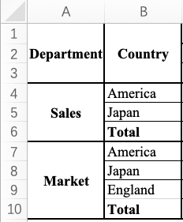
Header Pair Enumeration
Header types and relations are usually correlated
Predict two headers in a header pair together
Enumerate headers into a header pair
A1
Department
<A1, B1>
<A1, A4>
……
<B9,B10>
Extract
Enumerate
B1
Country
Header region
All headers
Header pairs
Notes:
Next, I will explain the details of our approach. For two headers in a spreadsheet table, their header types and relations are usually correlated. (click) In the first step, instead of predicting header types and relations independently, we predict them in a header pair together. (click)Given a header region, Tasi firstly extracts all headers. (click) For every two headers, Tasi forms a header pair.

Slide 15
Style Feature Extraction
Intra-header feature
Merged cell
Merged cell
Notes:
The second step is to extract features. We select style features such as merged cells. It is an intra-header feature. For example, cell A1 is a merged cell.

Slide 16
Content Feature Extraction
Intra-header feature
Aggregation caption: total, sum, and max
Aggregation caption
Notes:
We also extract content features such as aggregation caption. Aggregation headers always contain tokens like “total”, “sum” and “max”. For example, B6 is an aggregation caption

Slide 17
Spatial Feature Extraction
Inter-header feature
Relative location: h1 is located in the left and top of h2
Relative location
Notes:
We also extract spatial features such as relative locations. It is an inter-header feature. For example, header A4 is located in the left and top of B5, they are relative locations.

Slide 18
Feature Extraction Summary
Intra-header features
Style features
38 features
14 features
Contents features
8 features
Inter-header features
Spatial features
8 features
24 features
Notes:
We total extract 38 intra-header features for each header, and 8 inter-header features between two headers in a header pair.

Slide 19
Header Pair Structure Identification
Header pair structure
For header pair <h1, h2>, we predict its category <h1.type, h2.type, relation(h1, h2)>
Multi classifier
Random forest classifier
Feature
<A1, B1> →
< Index name,
Aggregation, No relation>
<A1, A4> →
< Index name, Index,
Index name - index >
Content
Style
Spatial
Calculate
Predict
46 features
Multi classifier
Header pair structure
Notes:
The third step is to identify header pair structures. (Click) For each header pair, Tasi extracts 46 features and predicts header types and the relation among headers. (click) We need to select a multi classifier. According to our experiments, when we use Random Forest algorithm, Tasi can obtain the best performance. (click) After we choose a suitable classifier, Tasi can predict the header pair structure.

Slide 20
Generate Consistent Table Structure
Has the high probability and is compatible with current structure
<A1, B1>
<Value name, Aggregation, No relation>: 0.9
<Index name, Index name, No relation>: 0.8
… …
<A1, A4>
<Index, Aggregation, Parent-child relation>: 0.9
<Index name, Index, Index name – index relation>: 0.8
… …
Consistent table structure
<A1, B1> → <Index name, Index name, No relation>
<A1, A4> → <Index name, Index, Index name – index relation>
……
Notes:
To generate a consistent table structure, we choose the header pair predict result, which has the highest probability and is compatible with current structure. For example, there are two predict results of header pair <A1, B1> and <A1, A4>. (Click)Firstly, we choose the highest predict results. However, the A1 type is inconsistent with two pairs. (Click)The second highest predict results have no conflict, (Click) so we choose them to form a consistent table structure.

Slide 21
Research Outline
Semantic table structure model
Semantic table structure identification
Structure-based error detection
Evaluation
Notes:
The third research part is structure-based error detection.

Slide 22
Missing Formula
Missing formula: a cell is supposed to contain a formula, but it does not
Missing formula：581,433=315,644+265,789
Notes:
There are two common spreadsheet error types, missing formulas and formula errors. The first is missing formulas，in which a cell is supposed to contain a formula but it does not. （Click）For example, in the table, the value of D6 is equal to the value of D4 plus D5. So D6 misses a formula.

Slide 23
Formula Error
Formula error: the formula in a cell is inconsistent with computations
Formula error
Notes:
The second is formula error, in which the formula is inconsistent with cell's corresponding computations. For example, in the table,(click) the formula of C10 added the cost of Sales when it calculated the cost of Market. So C10 contains a formula error.

Slide 24
TasiError Detection
The cells indexed by an index set share the similar computational semantics
Index set
Formula pattern is
SUM(R[-2]C:R[-1]C)
Missing formula：581,433=315,644+265,789
Notes:
By using table structures, we can easily identify missing formulas and formula errors. (Click) For example, C2-E2 belong to one index set. And the corresponding data cells include C6-E6. The cells indexed by an index set usually share the similar computational semantics. （Click）C6 has a formula. We extract the formula pattern. （Click） The value of D6 can be calculated in the same formula pattern. Therefore, we infer D6 is missed a formula.

Slide 25
TasiError Detection
The cells in a cell range should share the similar computational semantics
Cell range
Index set
Formula error
Notes:
In addition, every formula has a cell range. （Click）For example, the cell range of C10 is the red area.
The cells in a cell range usually belong to one index set and share the similar computational semantics.（Click）C7-C9 are indexed by index set B7-B9（Click）but C6 is not indexed by this index set. We infer the cell range contains more cells, thus introducing a formula error.

Slide 26
Research Outline
Semantic table structure model
Semantic table structure identification
Structure-based error detection
Evaluation
Notes:
The last research part is evaluation.

Slide 27
Evaluation
To evaluate the performance of Tasi
RQ1: How effective is Tasi in identifying semantic table structures in spreadsheets?
To evaluate the performance of TasiError
RQ2:What is the performance of TasiError in detecting spreadsheet errors?
To compare TasiError with existing error detection tools
RQ3: How is TasiError compared with existing tools?
Notes:
To evaluate our approach, we raise three questions. The first is to evaluate the performance of Tasi. The second is to evaluate the performance of TasiError. And the last is to compare TasiError with existing error detection tools.

Slide 28
Build Ground Truth
Experimental subject
4,290,022 spreadsheets from the Internet
Sample spreadsheets and manually label semantic table structures
9 data labelers in Speechocean [1]
Sample 3,500 spreadsheets and label semantic table structures
[1] Speechocean: A third-party artificial intelligence data provider. http://en.speechocean.com
Notes:
Because there is not such training data for semantic table structures, we firstly build a ground truth. We obtain more than 4 million spreadsheets from internet, and use them as our experimental subject.
We employ nine experienced data labelers in Speechocean. We randomly sample thirty five hundred (3500) spreadsheets, and label their semantic table structures.

Slide 29
Ground Truth
3,290 tables from 3,110 spreadsheets
80% as training dataset and 20% as testing dataset
Item | Train | Test | Total
Spreadsheet | 2,488 | 622 | 3,110
Table | 2,651 | 639 | 3,290
Left headers | 2,130 | 518 | 2,648
Top headers | 2,579 | 625 | 3,204
Left header pair | 929,617 | 258,747 | 1,188,364
Top header pair | 190,859 | 44,326 | 235,185
Notes:
Through the above sampling process, we obtain more than thirty two hundred (3,200) tables from about thirty one hundred (3,100) spreadsheets. We randomly split the spreadsheets into two parts, eighty percent (80%) as training data and twenty percent (20%) as testing data. The statistics are show in the table.

Slide 30
Semantic Table Structure Identification (RQ1)
Semantic table structure accuracy: 44.1%
339/625=54.2%
363/518=70.1%
282/639=44.1%
Notes:
After understanding the structure of our ground truth. We start to evaluate our approach.
Tasi can identify about seventy percent (70%) left header structures and (Click) about fifty-five percent (55%) top header structures. (Click) In total, Tasi can identify forty-four (44%) table structures without any errors.

Slide 31
Structure Based Error Detection (RQ2)
Ground truth
CUSTODES[ICSE’16]: 70 spreadsheets, 3702 errors
Precision: 75.2%
Recall: 82.9%
Category | Spreadsheet | Error | TasiError
 |  |  | Detect | True
cs101 | 1 | 6 | 1 | 1
database | 14 | 1,998 | 1,979 | 1,893
financial | 23 | 993 | 873 | 644
forms3 | 2 | 10 | 39 | 3
grade | 7 | 210 | 122 | 120
homework | 7 | 58 | 260 | 18
inventory | 9 | 86 | 260 | 62
modeling | 7 | 341 | 547 | 327
Total | 70 | 3,702 | 4,081 | 3,068
Notes:
For the second question, to evaluate TasiError, we adopt the CUSTODES dataset as our experimental subject. (Click) We fix the dataset and the seventy (70) spreadsheets contain about thirty seven hundred (3700) errors. We use TasiError to detect spreadsheet errors based on the semantic table structures. (Click) The precision of TasiError is seventy five percent (75%). the recall is eighty two percent (82.9%).

Slide 32
Compare with Existing Tools (RQ3)
Existing error detection tools
TasiError outperforms existing tools
Notes:
For the third question, we compare TasiError with existing error detection tools CUSTODES, CACheck, ExceLint, Excel internal error detector, Amcheck and Dimension in the same dataset. Through the result figure, we can see that TasiError significantly outperforms existing error detection tools in spreadsheet error detection.

Slide 33
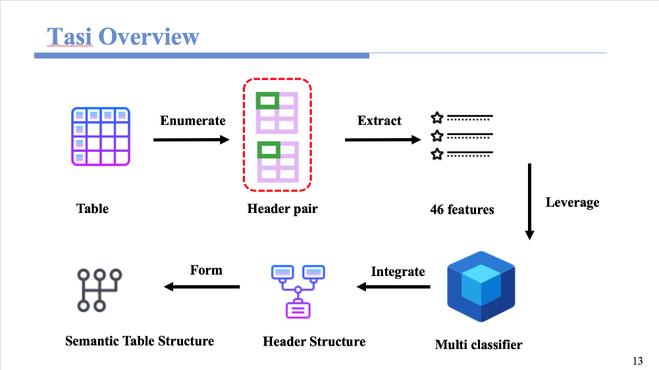
Summary
https://github.com/tcse-iscas/Tasi
Notes:
In summary, we firstly propose a semantic table structure model for structure understanding, which can accurately describe the table structures by header types and relations among headers. (Click) Furthermore, we propose a learning-based approach, Tasi, to identify semantic table structures in spreadsheets. (Click) Based on the identified semantic table structure, we propose TasiError, to effectively detect spreadsheet errors. (Click) Finally, we implement Tasi and TasiError, and evaluate them on real-world spreadsheets. The experimental results show that our approaches perform well in practice. (Click) We public a table structure dataset and a spreadsheet error dataset for future research.

Slide 34
Thank you!
Notes:
Thanks for your attention. Any question?

