Slide 1

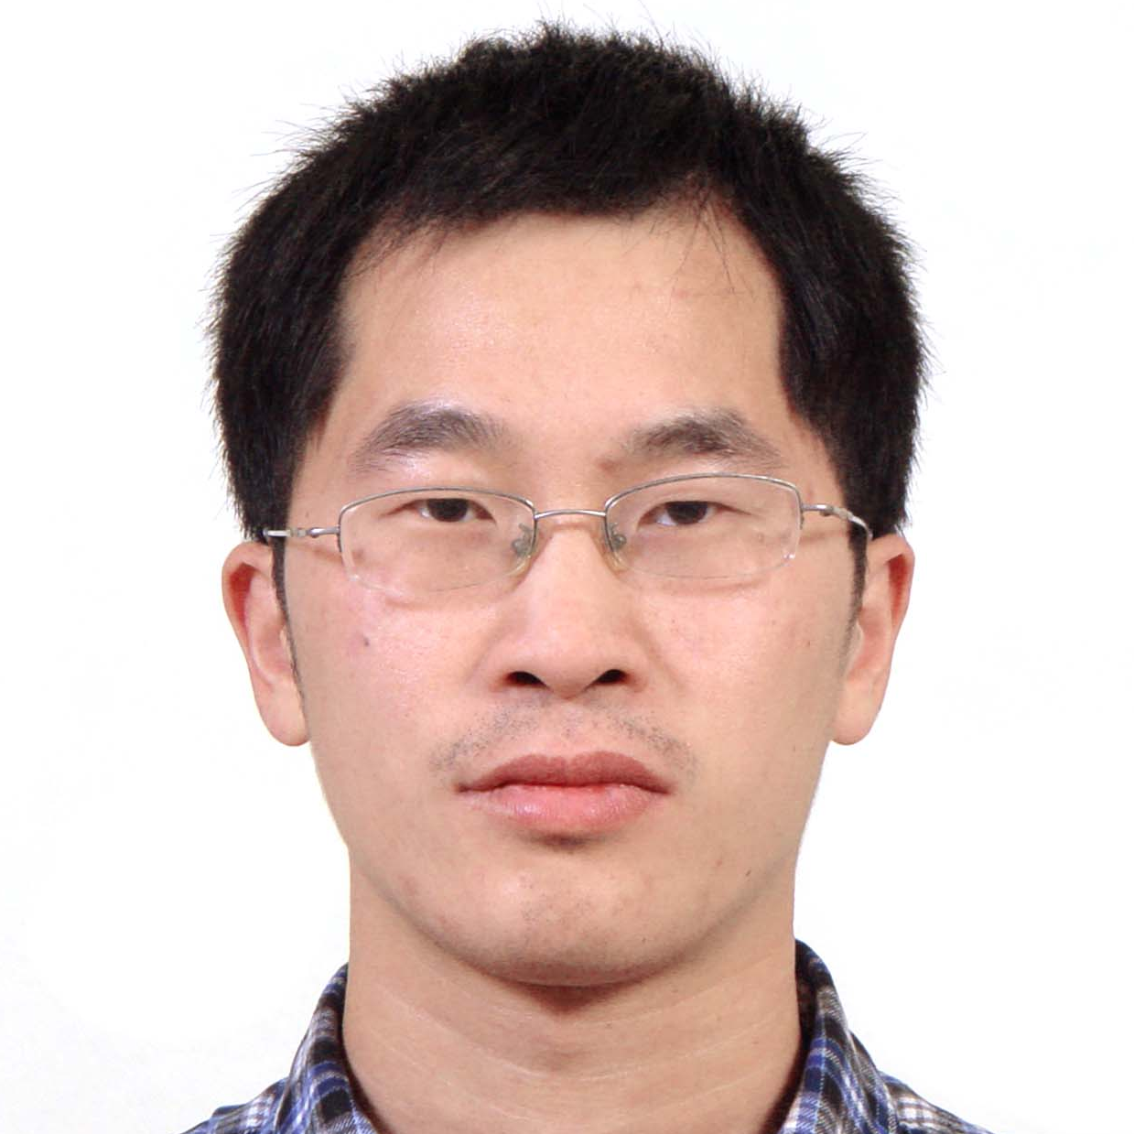

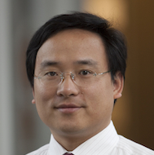


CoFI: Consistency-Guided Fault Injection for Cloud Systems
Haicheng Chen
Wensheng Dou
Dong Wang
Feng Qin
Institute of Software,
Chinese Academy of Sciences
The Ohio State University

Slide 2





Cloud systems are part of our daily life

Slide 3

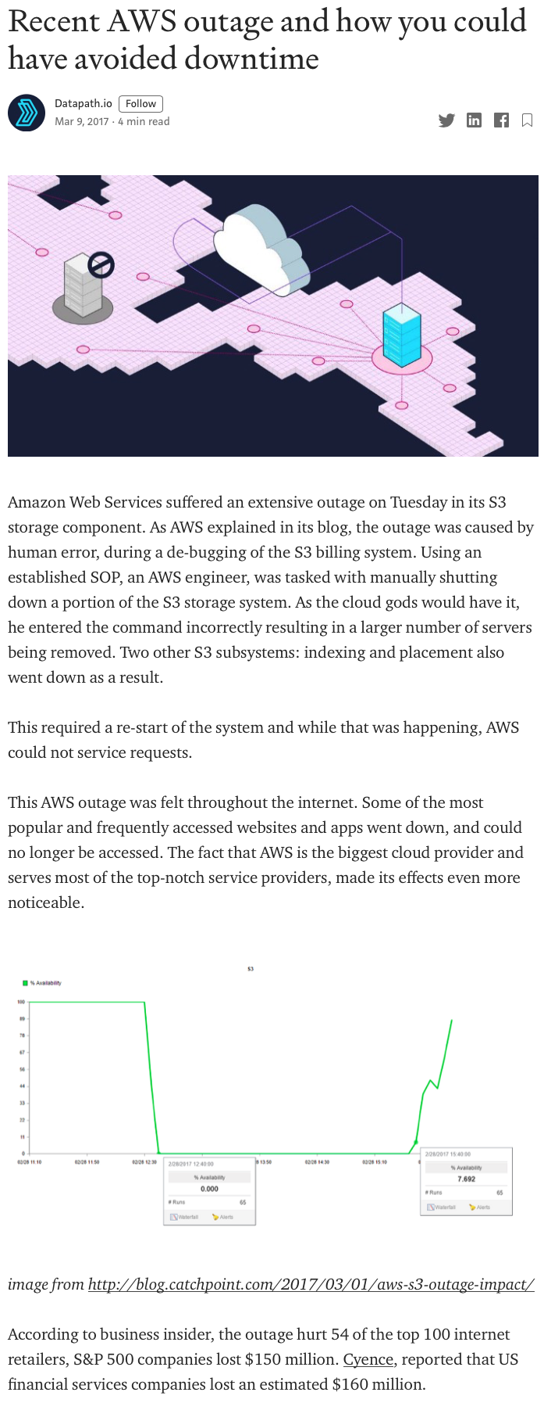
Cloud system dependability is critical

Slide 4




Network partitions are inevitable in the cloud
switch failure
power failure
incorrect configuration
“..., in production networks, network-partitioning faults occur as frequently as once a week ...”
-- [OSDI’18] An Analysis of Network-Partitioning Failures in Cloud Systems
image sources:
[switch] https://imgbin.com/png/y4kQzj5f/network-switch-computer-icons-computer-network-ethernet-png
[cable] https://imgbin.com/png/RABwrggD/computer-icons-network-cables-electrical-cable-png

Slide 5


Network partitions are inevitable in the cloud
A dependable cloud system must handle network partitions correctly.
switch failure
power failure
incorrect configuration
“..., in production networks, network-partitioning faults occur as frequently as once a week ...”
-- [OSDI’18] An Analysis of Network-Partitioning Failures in Cloud Systems
image sources:
[switch] https://imgbin.com/png/y4kQzj5f/network-switch-computer-icons-computer-network-ethernet-png
[cable] https://imgbin.com/png/RABwrggD/computer-icons-network-cables-electrical-cable-png

Slide 6
It is challenging to handle network partitions
I can happen to any node.
I can start at any time.
I can stop at any time.
😈
☹️
😈
😣
😈
🤯
Network
partition
Developer
Network
partition
Developer
Network
partition
Developer
Network partitions can still lead to failures in cloud systems.
😢

Slide 7
A bug triggered by a network partition
CASSANDRA-2115

Slide 8
A bug triggered by a network partition
C₁
C₂
C₁:(t₀,Normal)
GOSSIP{C₁:(t₀,Normal)}
C₁:(t₀,Normal)
status
clock
value
CASSANDRA-2115

Slide 9
A bug triggered by a network partition
C₁
C₂
C₁:(t₀,Normal)
GOSSIP{C₁:(t₀,Normal)}
C₁:(t₀,Normal)
status
clock
value
node ID
CASSANDRA-2115

Slide 10
A bug triggered by a network partition
C₁
C₂
C₃
①C₁:(t₀,Normal)
①C₁:(t₀,Normal)
CASSANDRA-2115

Slide 11
A bug triggered by a network partition
C₁
C₂
C₃
Decommission
C₁
GOSSIP{C₁:(t₁,Left)}
①C₁:(t₀,Normal)
①C₁:(t₀,Normal)
②C₁:(t₁,Left)
CASSANDRA-2115

Slide 12
A bug triggered by a network partition
C₁
C₂
C₃
GOSSIP{C₁:(t₁,Left)}
①C₁:(t₀,Normal)
①C₁:(t₀,Normal)
②C₁:(t₁,Left)
Network partition
③N*GOSSIP{C₁:(t₁,Left)}
③N*GOSSIP{C₁:(t₁,Left)}
CASSANDRA-2115

Slide 13

A bug triggered by a network partition
C₁
C₂
C₃
GOSSIP{C₁:(t₁,Left)}
①C₁:(t₀,Normal)
①C₁:(t₀,Normal)
②C₁:(t₁,Left)
Network partition
③N*GOSSIP{C₁:(t₁,Left)}
③N*GOSSIP{C₁:(t₁,Left)}
④C₁:()
CASSANDRA-2115

Slide 14
A bug triggered by a network partition
C₁
C₂
C₃
GOSSIP{C₁:(t₁,Left)}
①C₁:(t₀,Normal)
①C₁:(t₀,Normal)
②C₁:(t₁,Left)
Network partition
③N*GOSSIP{C₁:(t₁,Left)}
③N*GOSSIP{C₁:(t₁,Left)}
④C₁:()
⑤GOSSIP{C₁:(t₀,Normal)}
C₁:(t₀,Normal)
/* Shouldn’t become Normal again */
CASSANDRA-2115

Slide 15
A bug triggered by a network partition
C₁
C₂
C₃
GOSSIP{C₁:(t₁,Left)}
①C₁:(t₀,Normal)
①C₁:(t₀,Normal)
Network partition should start after ① but before ③.
②C₁:(t₁,Left)
Network partition
③N*GOSSIP{C₁:(t₁,Left)}
③N*GOSSIP{C₁:(t₁,Left)}
④C₁:()
Network partition should stop after ④ but before ⑤.
⑤GOSSIP{C₁:(t₀,Normal)}
C₁:(t₀,Normal)
/* Shouldn’t become Normal again */
CASSANDRA-2115

Slide 16


partition bug
noun
  a bug that is triggered by network partitions.

Slide 17
Existing fault injection tools are not effective
Do not inject network partitions.
  Node crash: FCatch, CrashTuner, ...
  File system faults: CORDS, ...
  Unreliable network: Namazu, ...
Inject network partitions but require manually specifying the timing.
  NEAT, Jepsen

Slide 18
CoFI: Consistency-guided Fault Injection

Slide 19
Main observations
Network partitions can leave a cloud system in inconsistent states.
Partition bugs are more likely to occur in inconsistent states.

Slide 20

CoFI’s idea
inconsistent
C₁
C₂
C₃
GOSSIP{C₁:(t₁,Left)}
①C₁:(t₀,Normal)
①C₁:(t₀,Normal)
②C₁:(t₁,Left)
Network partition
③N*GOSSIP{C₁:(t₁,Left)}
③N*GOSSIP{C₁:(t₁,Left)}
inconsistent
Control the timing of the network partition to thoroughly exercise a cloud system in inconsistent states.
④C₁:()
⑤GOSSIP{C₁:(t₀,Normal)}
C₁:(t₀,Normal)
/* Shouldn’t become Normal again */

Slide 21
Challenge 1: How to represent and decide consistent states?
How to represent consistent states in different cloud systems?
implementation
...
🤔
Google Spanner’s
Cassandra’s
protocol
Paxos
Replication Pipeline
Two-Phase Commit
...

Slide 22
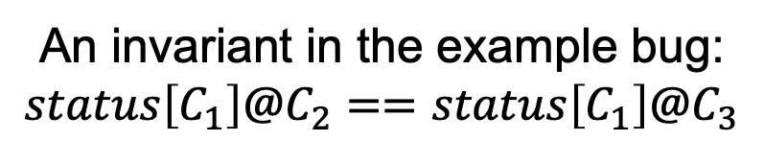
Challenge 1: How to represent and decide consistent states?
Use distributed program invariants to represent consistent states.
An invariant in the example bug:
$$status\left[C_{1}\right]@C_{2}==status\left[C_{1}\right]@C_{3}$$
😉
CASSANDRA-2115

Slide 23
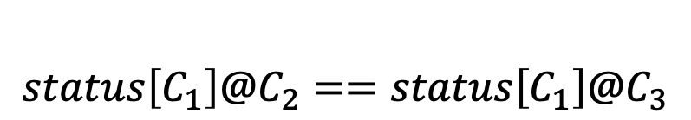
Challenge 1: How to represent and decide consistent states?
An invariant is satisfied in a state → The state is consistent.
An invariant is violated in a state → The state is inconsistent.
C₂
consistent
C₃
①C₁:(t₀,Normal)
①C₁:(t₀,Normal)
State 1
$$status\left[C_{1}\right]@C_{2}==status\left[C_{1}\right]@C_{3}$$
②C₁:(t₁,Left)
inconsistent
State 2
inconsistent
④C₁:()
State 3
CASSANDRA-2115

Slide 24
Challenge 2: When to start a network partition?
C₁
C₂
C₃
GOSSIP{C₁:(t₁,Left)}
①C₁:(t₀,Normal)
①C₁:(t₀,Normal)
②C₁:(t₁,Left)
Network partition
③N*GOSSIP{C₁:(t₁,Left)}
?
③N*GOSSIP{C₁:(t₁,Left)}
When to start a network partition?
④C₁:()
🤔
⑤GOSSIP{C₁:(t₀,Normal)}
C₁:(t₀,Normal)
/* Shouldn’t become Normal again */

Slide 25
Challenge 2: When to start a network partition?
inconsistent
C₁
C₂
C₃
GOSSIP{C₁:(t₁,Left)}
①C₁:(t₀,Normal)
①C₁:(t₀,Normal)
②C₁:(t₁,Left)
Network partition
③N*GOSSIP{C₁:(t₁,Left)}
③N*GOSSIP{C₁:(t₁,Left)}
Start network partitions when the cloud system is inconsistent.
④C₁:()
⑤GOSSIP{C₁:(t₀,Normal)}
😉
C₁:(t₀,Normal)
/* Shouldn’t become Normal again */

Slide 26
Challenge 3: When to stop a network partition?
C₁
C₂
C₃
GOSSIP{C₁:(t₁,Left)}
①C₁:(t₀,Normal)
①C₁:(t₀,Normal)
②C₁:(t₁,Left)
Network partition
③N*GOSSIP{C₁:(t₁,Left)}
③N*GOSSIP{C₁:(t₁,Left)}
When to stop a network partition?
All N messages have the same effect on the system.
④C₁:()
🤔
⑤GOSSIP{C₁:(t₀,Normal)}
C₁:(t₀,Normal)
/* Shouldn’t become Normal again */

Slide 27
Challenge 3: When to stop a network partition?
C₁
C₂
C₃
GOSSIP{C₁:(t₁,Left)}
①C₁:(t₀,Normal)
①C₁:(t₀,Normal)
②C₁:(t₁,Left)
Network partition
③N*GOSSIP{C₁:(t₁,Left)}
③N*GOSSIP{C₁:(t₁,Left)}
Stop network partitions before each type of messages.
Same type of messages.
④C₁:()
⑤GOSSIP{C₁:(t₀,Normal)}
😉
C₁:(t₀,Normal)
/* Shouldn’t become Normal again */

Slide 28
CoFI’s workflow
Stage 1: Invariant Mining
Stage 2: Fault Injection

Slide 29


CoFI’s workflow
Stage 1: Invariant Mining
Stage 2: Fault Injection
cloud system
workload
Profiling
variable
values

Slide 30

CoFI’s workflow
Stage 1: Invariant Mining
Stage 2: Fault Injection
cloud system
workload
Profiling
variable
values
State Construction
Invariants
system
states
Invariant Mining

Slide 31
CoFI’s workflow
Stage 1: Invariant Mining
Stage 2: Fault Injection
cloud system
workload
cloud system
workload
Profiling
variable
values
Testing
State Construction
Invariants
system
states
Invariant Mining

Slide 32



CoFI’s workflow
Stage 1: Invariant Mining
Stage 2: Fault Injection
cloud system
workload
cloud system
workload
Profiling
Bug Reports
checker
variable
values
Testing
partition
scenarios
system states &
message types
State Construction
Invariants
system
states
Partition Scenario Generation
Invariant Mining

Slide 33



Stage 1: Invariant mining
Stage 1: Invariant Mining
cloud system
workload
C₂
C₃
②
C₁:(t₁,Left)
Profiling
before-send
③GOSSIP{C₁:(t₁,Left)}
variable
values
State Construction
C₁:(t₁,Left)
after-handle
system
states
Invariant Mining
Invariants

Slide 34
Stage 1: Invariant mining
Stage 1: Invariant Mining
cloud system
workload
C₂
C₃
②
C₁:(t₁,Left)
Profiling
before-send
③GOSSIP{C₁:(t₁,Left)}
variable
values
State Construction
C₁:(t₁,Left)
after-handle
system
states
consistent
Invariant Mining
Invariants

Slide 35
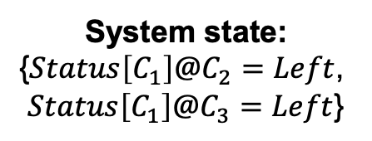
Stage 1: Invariant mining
Stage 1: Invariant Mining
cloud system
workload
C₂
C₃
②
C₁:(t₁,Left)
Profiling
before-send
③GOSSIP{C₁:(t₁,Left)}
variable
values
State Construction
C₁:(t₁,Left)
after-handle
system
states
System state:
{$Status\left[C_{1}\right]@C_{2}=Left$,
$Status\left[C_{1}\right]@C_{3}=Left$}
Invariant Mining
Invariants

Slide 36
Stage 2: Fault injection
CoFI’s fault model: Inject one temporary network partition to one node per test run.
N₁
N₂
N₃
Partition starts
messages
Network partition on N₃
messages
messages
Partition stops

Slide 37
Stage 2: Fault injection
CoFI’s fault model: Inject one temporary network partition to one node per test run.
N₁
N₂
N₃
messages
Network partition on N₃
messages
messages

Slide 38

Stage 2: Fault injection
CoFI’s workflow in one test run.
Select a state & a node based on the invariant

Slide 39


Stage 2: Fault injection
CoFI’s workflow in one test run.
no
Run the system
Start a partition
yes
Select a state & a node based on the invariant
Reach the selected state?

Slide 40

Stage 2: Fault injection
CoFI’s workflow in one test run.
no
no
Run the system
Start a partition
Stop the partition
yes
yes
Select a state & a node based on the invariant
Reach the selected state?
New message type?

Slide 41

Stage 2: Fault injection
Invariant: $status\left[C_{1}\right]@C_{2}==status\left[C_{1}\right]@C_{3}$
Inconsistent state: $\left\{status\left[C_{1}\right]@C_{2}=Left,status\left[C_{1}\right]@C_{3}=Normal\right\}$

Slide 42

Stage 2: Fault injection
Invariant: $status\left[C_{1}\right]@C_{2}==status\left[C_{1}\right]@C_{3}$
Inconsistent state: $\left\{status\left[C_{1}\right]@C_{2}=Left,status\left[C_{1}\right]@C_{3}=Normal\right\}$
Partition node: $C_{3}$

Slide 43

Stage 2: Fault injection
Invariant: $status\left[C_{1}\right]@C_{2}==status\left[C_{1}\right]@C_{3}$
Inconsistent state: $\left\{status\left[C_{1}\right]@C_{2}=Left,status\left[C_{1}\right]@C_{3}=Normal\right\}$
Partition node: $C_{3}$
Run #1
C₁
C₂
C₃
①Left
Normal
Normal
Left
NP
Tried stopping network partition before message types:

Slide 44
Stage 2: Fault injection
Invariant: $status\left[C_{1}\right]@C_{2}==status\left[C_{1}\right]@C_{3}$
Inconsistent state: $\left\{status\left[C_{1}\right]@C_{2}=Left,status\left[C_{1}\right]@C_{3}=Normal\right\}$
Partition node: $C_{3}$
Run #1
C₁
C₂
C₃
①Left
Normal
Normal
Left
②Left
Left
Tried stopping network partition before message types:
{C₂→C₃, Gossip}

Slide 45
Stage 2: Fault injection
Invariant: $status\left[C_{1}\right]@C_{2}==status\left[C_{1}\right]@C_{3}$
Inconsistent state: $\left\{status\left[C_{1}\right]@C_{2}=Left,status\left[C_{1}\right]@C_{3}=Normal\right\}$
Partition node: $C_{3}$
Run #1
Run #2
C₁
C₂
C₃
C₁
C₂
C₃
①Left
Normal
Normal
①Left
Normal
Normal
Left
②Left
Left
②Left
Left
Tried stopping network partition before message types:
{C₂→C₃, Gossip}

Slide 46
Stage 2: Fault injection
Invariant: $status\left[C_{1}\right]@C_{2}==status\left[C_{1}\right]@C_{3}$
Inconsistent state: $\left\{status\left[C_{1}\right]@C_{2}=Left,status\left[C_{1}\right]@C_{3}=Normal\right\}$
Partition node: $C_{3}$
Run #1
Run #2
C₁
C₂
C₃
C₁
C₂
C₃
①Left
Normal
Normal
①Left
Normal
Normal
Left
②Left
Left
②Left
Left
③Left
Left
Tried stopping network partition before message types:
{C₂→C₃, Gossip}, {C₁→C₃, Gossip}

Slide 47
Stage 2: Fault injection
Invariant: $status\left[C_{1}\right]@C_{2}==status\left[C_{1}\right]@C_{3}$
Inconsistent state: $\left\{status\left[C_{1}\right]@C_{2}=Left,status\left[C_{1}\right]@C_{3}=Normal\right\}$
Partition node: $C_{3}$
Run #1
Run #2
Run #3
C₁
C₂
C₃
C₁
C₂
C₃
C₁
C₂
C₃
①Left
Normal
Normal
①Left
Normal
Normal
①Left
Normal
Normal
Left
②Left
Left
②Left
Left
②N*Left
Left
③Left
③N*Left
Left
④∅
Tried stopping network partition before message types:
{C₂→C₃, Gossip}, {C₁→C₃, Gossip}

Slide 48
Stage 2: Fault injection
Invariant: $status\left[C_{1}\right]@C_{2}==status\left[C_{1}\right]@C_{3}$
Inconsistent state: $\left\{status\left[C_{1}\right]@C_{2}=Left,status\left[C_{1}\right]@C_{3}=Normal\right\}$
Partition node: $C_{3}$
Run #1
Run #2
Run #3
C₁
C₂
C₃
C₁
C₂
C₃
C₁
C₂
C₃
①Left
Normal
Normal
①Left
Normal
Normal
①Left
Normal
Normal
Left
②Left
Left
②Left
Left
②N*Left
Left
③Left
③N*Left
Left
④∅
⑤Normal
Normal
Tried stopping network partition before message types:
{C₂→C₃, Gossip}, {C₁→C₃, Gossip}, {C₃→C₂, Gossip}

Slide 49
Evaluation

Slide 50
Research questions
RQ1: How effective is CoFI in detecting partition bugs?
RQ2: How does CoFI compare to alternative approaches?
RQ3: How efficient is CoFI?

Slide 51
RQ1: Detecting partition bugs
Target systems: Cassandra, HDFS, and YARN.
Workloads: Common user/admin operations (e.g., write data and node failover).
Checkers: General failures (e.g., node crashes) and operation-specific failures (e.g., reading stale data).

Slide 52
RQ1: Detecting partition bugs
Bug ID | Stop | Status
CASSANDRA-15758 | ✓ | Pending
CASSANDRA-15548 | ⨉ | Confirmed
CASSANDRA-15546 | ⨉ | Pending
CASSANDRA-15437 | ⨉ | Pending
CASSANDRA-11804 | ⨉ | Confirmed
HDFS-15367 | ✓ | Pending
HDFS-15235 | ✓ | Confirmed
YARN-10301 | ✓ | Pending
YARN-10294 | ✓ | Pending
YARN-10288 | ✓ | Confirmed
YARN-10232 | ✓ | Pending
YARN-10231 | ✓ | Pending
CoFI detects 12 unknown partition bugs.

Slide 53
RQ1: Detecting partition bugs
Bug ID | Stop | Status
CASSANDRA-15758 | ✓ | Pending
CASSANDRA-15548 | ⨉ | Confirmed
CASSANDRA-15546 | ⨉ | Pending
CASSANDRA-15437 | ⨉ | Pending
CASSANDRA-11804 | ⨉ | Confirmed
HDFS-15367 | ✓ | Pending
HDFS-15235 | ✓ | Confirmed
YARN-10301 | ✓ | Pending
YARN-10294 | ✓ | Pending
YARN-10288 | ✓ | Confirmed
YARN-10232 | ✓ | Pending
YARN-10231 | ✓ | Pending
CoFI detects 12 unknown partition bugs.
4 bugs have been confirmed by developers.

Slide 54
RQ1: Detecting partition bugs
Bug ID | Stop | Status
CASSANDRA-15758 | ✓ | Pending
CASSANDRA-15548 | ⨉ | Confirmed
CASSANDRA-15546 | ⨉ | Pending
CASSANDRA-15437 | ⨉ | Pending
CASSANDRA-11804 | ⨉ | Confirmed
HDFS-15367 | ✓ | Pending
HDFS-15235 | ✓ | Confirmed
YARN-10301 | ✓ | Pending
YARN-10294 | ✓ | Pending
YARN-10288 | ✓ | Confirmed
YARN-10232 | ✓ | Pending
YARN-10231 | ✓ | Pending
CoFI detects 12 unknown partition bugs.
4 bugs have been confirmed by developers.
8 bugs require stopping the network partition to trigger.

Slide 55
RQ1: Detecting partition bugs
Bug ID | Stop | Status
CASSANDRA-15758 | ✓ | Pending
CASSANDRA-15548 | ⨉ | Confirmed
CASSANDRA-15546 | ⨉ | Pending
CASSANDRA-15437 | ⨉ | Pending
CASSANDRA-11804 | ⨉ | Confirmed
HDFS-15367 | ✓ | Pending
HDFS-15235 | ✓ | Confirmed
YARN-10301 | ✓ | Pending
YARN-10294 | ✓ | Pending
YARN-10288 | ✓ | Confirmed
YARN-10232 | ✓ | Pending
YARN-10231 | ✓ | Pending
One of the bugs cannot be triggered by injecting network partitions at the user-operation level.

Slide 56
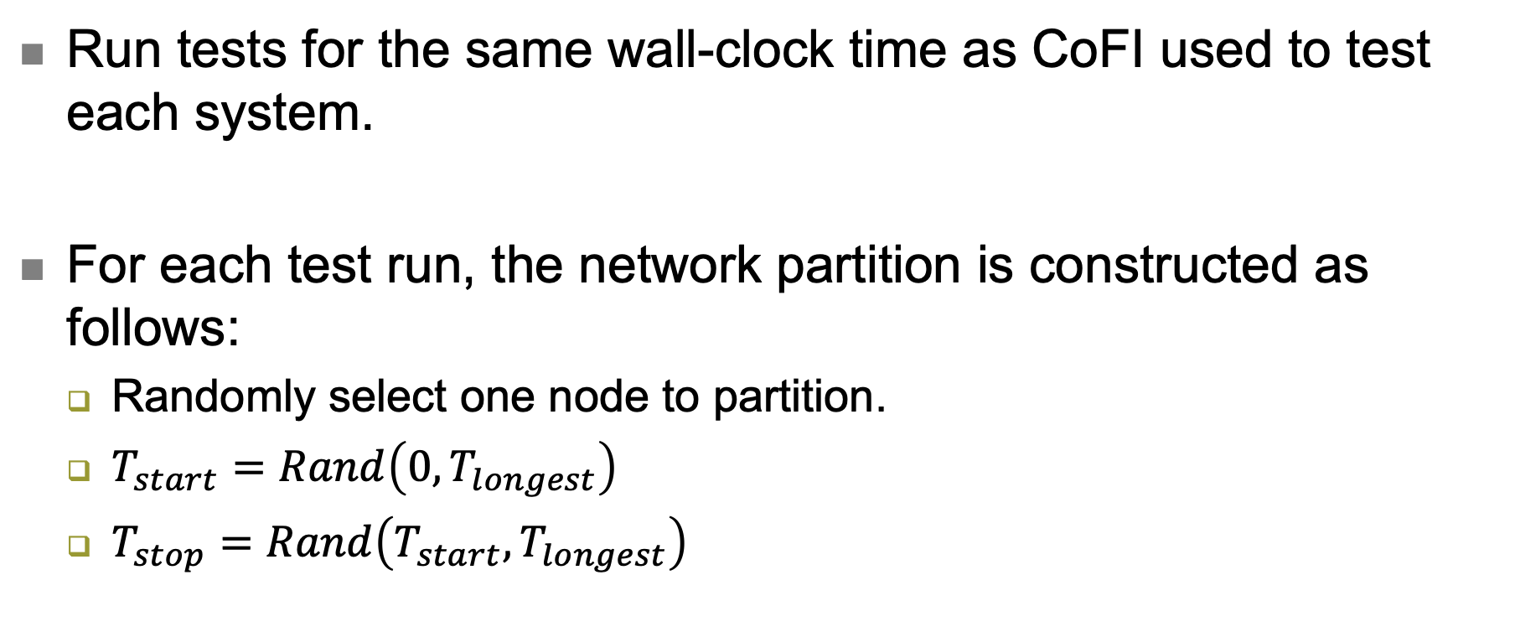
RQ2: Comparing with random injection
Run tests for the same wall-clock time as CoFI used to test each system.
For each test run, the network partition is constructed as follows:
  Randomly select one node to partition.
  $T_{start}=Rand\left(0, T_{longest}\right)$
  $T_{stop}=Rand\left(T_{start}, T_{longest}\right)$

Slide 57
RQ2: Comparing with random injection
Bug ID | Stop | Random
CASSANDRA-15758 | ✓ | ✓
CASSANDRA-15548 | ⨉ | ✓
CASSANDRA-15546 | ⨉ | ⨉
CASSANDRA-15437 | ⨉ | ✓
CASSANDRA-11804 | ⨉ | ✓
HDFS-15367 | ✓ | ✓
HDFS-15235 | ✓ | ⨉
YARN-10301 | ✓ | ⨉
YARN-10294 | ✓ | ⨉
YARN-10288 | ✓ | ⨉
YARN-10232 | ✓ | ⨉
YARN-10231 | ✓ | ✓
Random injection only triggers 6 bugs that are triggered by CoFI.
Random injection does not trigger any bug that is new to CoFI.

Slide 58
RQ3: How efficient is CoFI?
System | Test Runs
 | Iterations | Time | Time/Iteration
Cassandra-3.11.5 | 9,366 | 222h, 20m | 1.4m
HDFS-3.3.0 | 944 | 24h, 9m | 1.5m
HDFS-2.10.0 | 1,305 | 39h, 41m | 1.8m
YARN-3.3.0 | 1,151 | 240h, 11m | 12.5m
YARN-2.10.0 | 250 | 58h, 59m | 14.2m
Total | 13,016 | 585h, 20m | 2.7m

Slide 59
Conclusion
Partition bugs need more attention from our communities.
CoFI can effectively detect partition bugs by systematically and smartly injecting network partitions to cloud systems.
CoFI is available at https://hanseychen.github.io/CoFI.

Slide 60
Thank you!
Questions?

