Slide 1
Expandable Group Identification in Spreadsheets
International Conference on Automated Software Engineering (ASE 2018)
Wensheng Dou, Shi Han, Liang Xu, Dongmei Zhang, Jun Wei
University of Chinese Academy of Sciences
Institute of Software Chinese Academy of Sciences
^{Microsoft Research Asia}

Slide 2
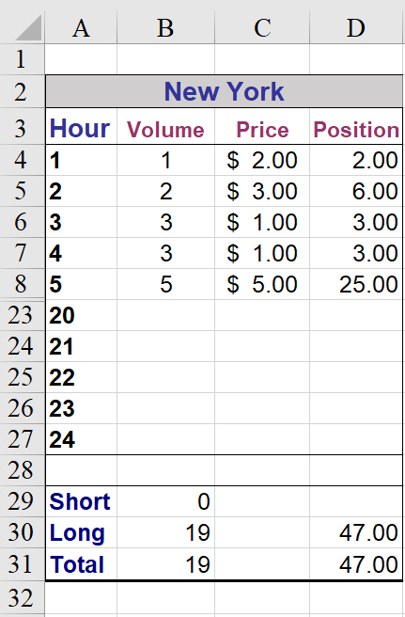
Spreadsheet example
Header: Describe other data
Data for 24 hours
Statistics
… real example extracted from Enron spreadsheet corpus

Slide 3
Expandable group
Expandable group: A basic unit and all its repeating units form an expandable group
All units have similar formats and semantics
Different semantics

Slide 4
Expandable group – Vex group
Expandable group: A basic unit and all its repeating units form an expandable group
Vex group: The basic unit is vertically expanded

Slide 5
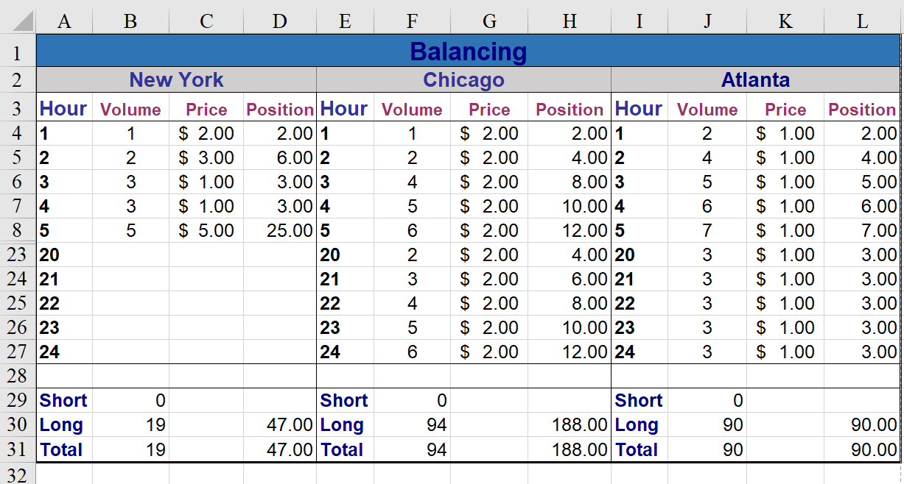
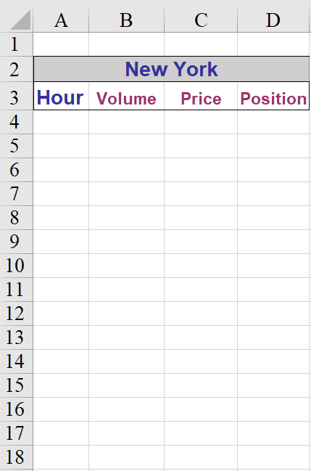
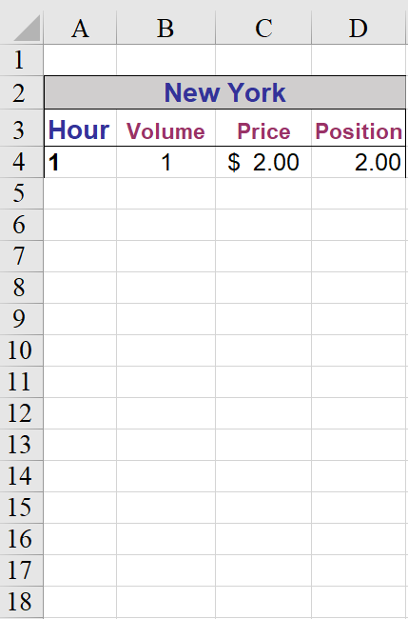
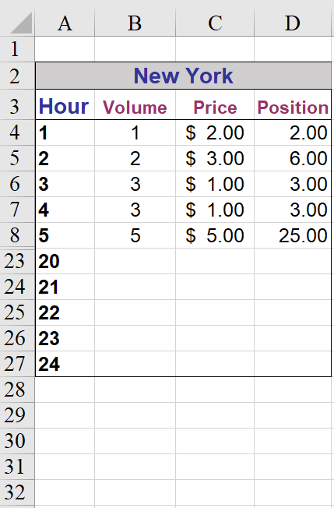
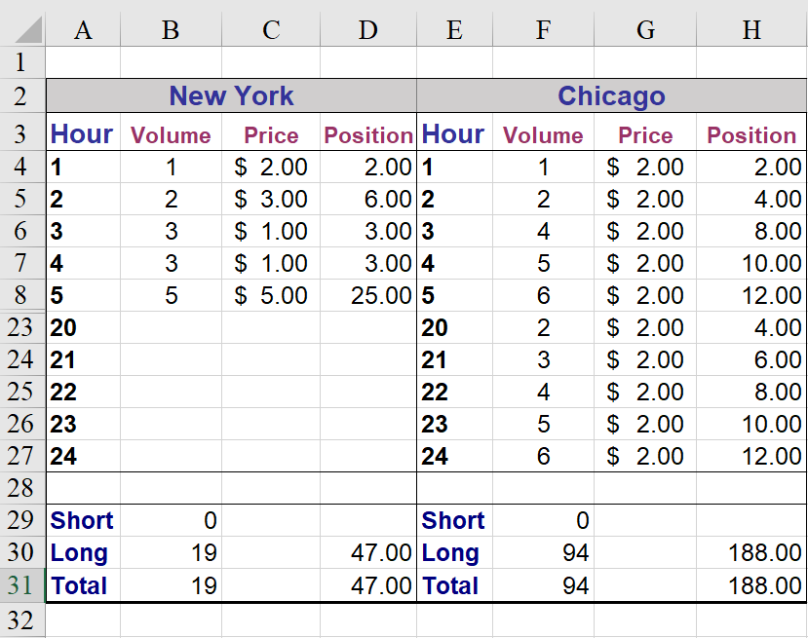
Expandable group – Hex group
Hex group: The basic unit is horizontally expanded

Slide 6
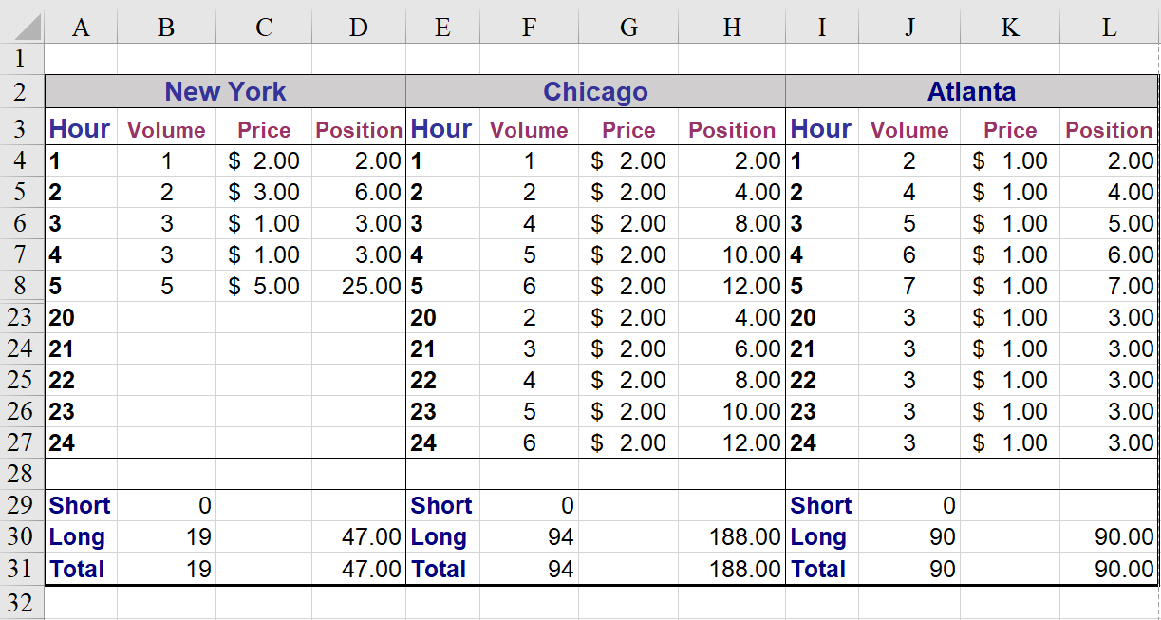
Structure information is missing
Structure information is not stored with spreadsheets

Slide 7
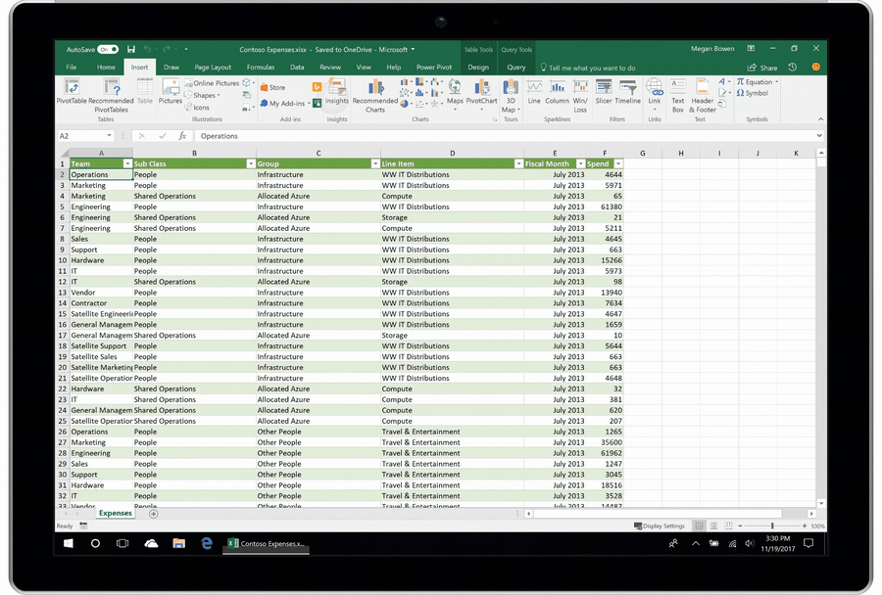
Structure information is missing
Spreadsheet data cannot be consumed by analysis tools
What data in it?
Data integration
Insights in Excel
Data mining

Slide 8
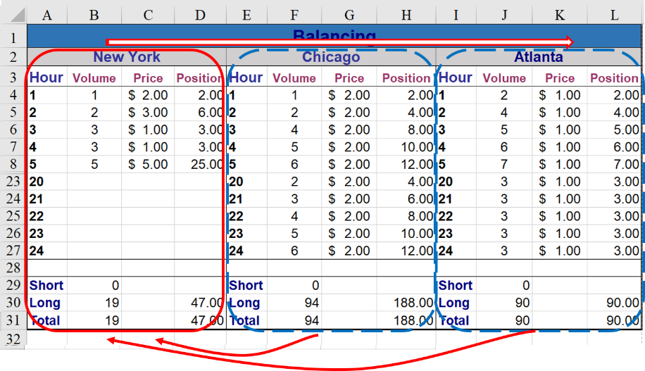
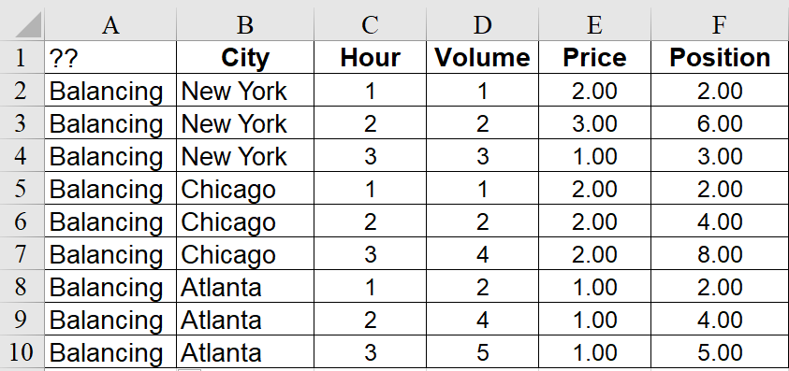
How can we use expandable groups?
Non-Relational
Data
Relational
Data
Analysis-friendly

Slide 9
Our goal
ExpCheck
Automatically identify expandable groups in spreadsheets

Slide 10
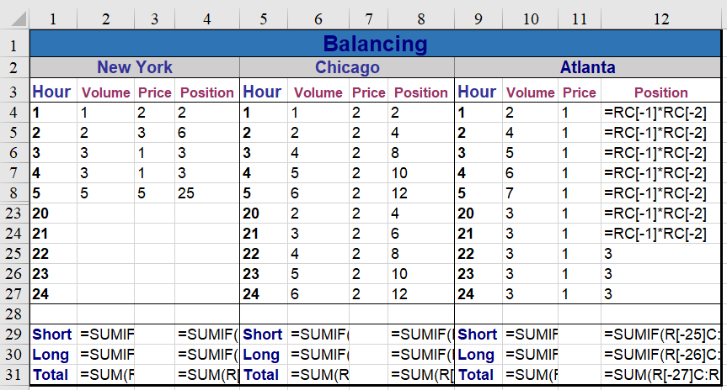
Existing approach
Identify expandable groups based on formula patterns[1]
[1] R. Abraham, et, al., “Inferring Templates from Spreadsheets”, ICSE 2006.

Slide 11
Existing approach - Issues (1)
Formulas may be missing

Slide 12
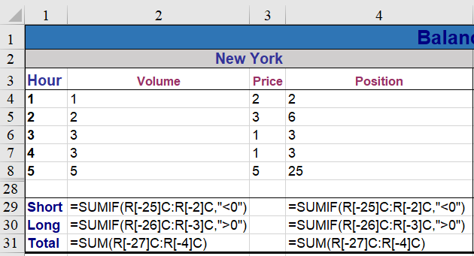
Existing approach - Issues (2)
Same formula patterns don’t mean they are expandable
Not expandable

Slide 13
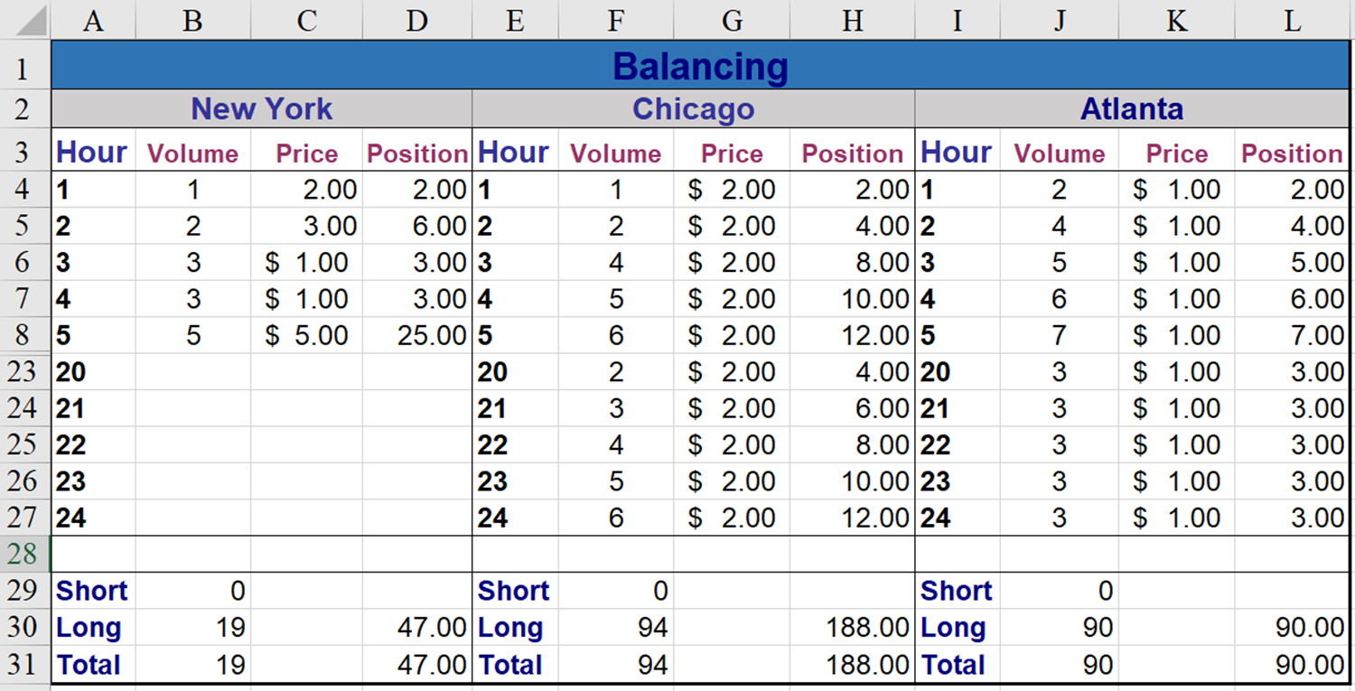
Key observation (1)
Corresponding cells have the same format

Slide 14
Key observation (2)
Corresponding headers have the similar semantics
Similar semantics

Slide 15
How to compare two cells in format?
Compare two cells with their type features
Cell type
Label
Data

Slide 16
How to compare two cells in format?
Compare two cells with their format features
Merge: Whether a cell is merged?
Merged
Not merged

Slide 17
How to compare two cells in format?
Compare two cells with their format features
Merge: Whether a cell is merged?
Font: Font name, size, color
Different color

Slide 18
How to compare two cells in format?
Compare two cells with their format features
Merge: Whether a cell is merged?
Font: Font name, size, color
Data format: #.## vs. $ #.##
2.00
$ 1.00

Slide 19
Compare two columns in format
Can we require that all corresponding cells use the same format?
We require that a majority (60%) of corresponding cells use the same format

Slide 20
Header semantics
Headers in spreadsheets represent cells’ semantics
Different semantics

Slide 21
How to compare headers?
In Word2Vec, two words with similar semantics are usually located closely in the vector space
New York – Chicago: similar
New York – Fruit: dissimilar
We utilize Word2Vec to compute the semantic similarity among two headers
Use pre-trained Word2Vec model [1] on Google News dataset
[1] GoogleNews-vectors-negative300.bin.gz. https://drive.google.com/file/d/0B7XkCwpI5KDYNlNUTTlSS21pQmM.

Slide 22
How to detect expandable groups?
Basic unit with 1 column
Basic unit

Slide 23
How to find expandable groups?
Basic unit with 1 column
Basic unit

Slide 24
How to find expandable groups?
Basic unit with 2 columns
Basic unit

Slide 25
How to find expandable groups?
Basic unit with 3 columns
Basic unit

Slide 26
How to find expandable groups?
Basic unit with 4 columns
Basic unit

Slide 27
Evaluation
RQ1: Can ExpCheck detect expandable groups effectively?
RQ2: How is ExpCheck compared with existing techniques?

Slide 28
Build ground truth
Experimental subject
EUSES [1]
VEnron [2]
Sample spreadsheets and manually extract all expandable groups
Keep one for similar spreadsheets
Keep one for similar worksheets
Diversity
[1] M. Fisher et al., “The EUSES spreadsheet corpus: a shared resource for supporting experimentation with spreadsheet dependability mechanisms,” SIGSOFT Softw Eng Notes, 2005.
[2] W. Dou et al., “VEnron: A Versioned Spreadsheet Corpus and Related Evolution Analysis,” ICSE SEIP, 2016

Slide 29
Ground truth
Corpus | Category | Spreadsheet | Worksheet | Expandable Group
EUSES | cs101 | 1 | 1 | 3
 | database | 11 | 12 | 27
 | financial | 10 | 10 | 17
 | forms3 | 1 | 1 | 1
 | grades | 5 | 5 | 10
 | homework | 13 | 15 | 36
 | inventory | 17 | 17 | 41
 | modeling | 12 | 12 | 13
VEnron |  | 50 | 66 | 165
Total |  | 120 | 139 | 313

Slide 30
Is ExpCheck effective? (RQ1)
Precision: 69.3%
Recall: 77.3%
Corpus | Category | Ground Truth | Detected | Confirmed
EUSES | cs101 | 3 | 4 | 3
 | database | 27 | 29 | 23
 | financial | 17 | 18 | 6
 | forms3 | 1 | 1 | 1
 | grades | 10 | 10 | 9
 | homework | 36 | 38 | 29
 | inventory | 41 | 44 | 35
 | modeling | 13 | 18 | 6
VEnron |  | 165 | 187 | 130
Total |  | 313 | 349 | 242

Slide 31
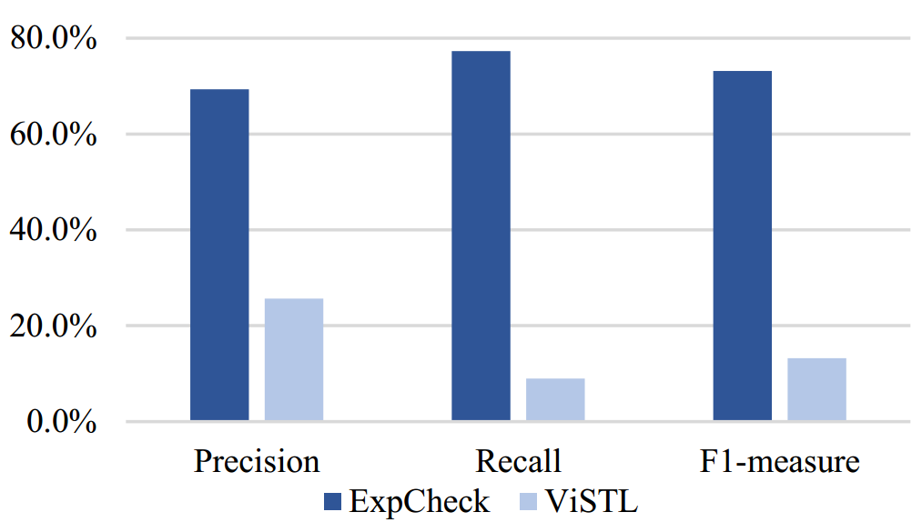
Compare with others (RQ2)
Formula pattern based approach [1]
[1] R. Abraham et al., “Inferring Templates from Spreadsheets,” ICSE 2006.

Slide 32
Summary
Expandable groups are the fundamental structure in spreadsheets. The corresponding cells in an expandable group have the similar format and semantics
ExpCheck: automatically identify expandable groups in spreadsheets
Result
ExpCheck performs much better than existing techniques
http://www.tcse.cn/~wsdou/project/ExpCheck/

Slide 33
Thank you!

